Slide 1

New & Emerging Laws affecting the Water Industry
CWWA 2025 Compliance Assistance Workshop

Slide 2
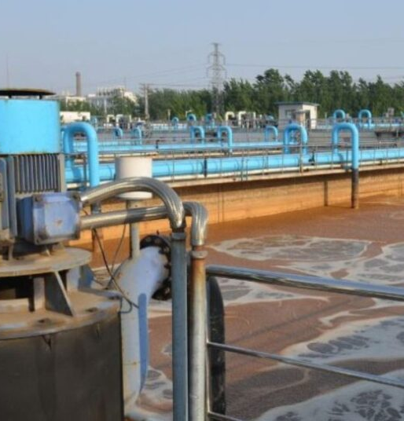
Water Quality Treatment Surcharges
Public Act 25-142 (HB-6777) authorizes the Public Utilities Regulatory Authority (PURA) to allow PURA-regulated water companies to recover their expenses for certain projects PURA determines are necessary to meet state or federal drinking water regulations.
To do so, it establishes a process for water companies to apply for, and PURA to approve, these expenses the company incurs between rate cases. If approved, the water company may recover the expenses through a water quality and treatment surcharge, a separate line item on customers’ bills.
Eligible projects are those that PURA determines are major additions, upgrades, improvements, or replacements of critical elements of water infrastructure that are necessary to meet state or federal drinking water regulations adopted or amended after December 16, 2021.
To be eligible, a project may not be covered by either the water company’s rate base or a water infrastructure and conservation adjustment and may be completed in a single year or over multiple years.
Effective July 1, 2025.

Slide 4
Climate Resiliency Bill
Public Act 25-33 (SB-9) includes numerous provisions aimed at addressing climate change impacts, including the following language of interest to water companies:
State Water Plan - Requires the State Water Plan in its next periodic update to:
Consider the potential impact of climate change on the quality of water resources,
Take into account past conditions and predictions of future temperatures and precipitation when identifying the quantities and qualities of water that are available for public water supply, health, economic, recreation and environmental benefits on a regional basin scale considering both surface water and groundwater, and
Include recommendations and an implementation plan to reduce impacts from climate change and extreme weather events on water quality and quantity.
Water Supply Regulations/Sewage Disposal
Not later than 12/31/28, the bill requires DEEP, DPH, & PURA to update water supply regulations and every ten years thereafter to include the most concurrent projections on precipitation, temperature, and other conditions that could impact water quality, quantity, and distribution.
Requires DEEP and DPH to update their sewage disposal system permitting processes/regulations every 10 years to include the most concurrent projections on precipitation, flooding, sea level rise, and other conditions that could impact public safety and environmental quality.

Slide 6

Climate Change Impacts – Nature-Based Solutions
Public Act 25-125 (HB-5004) requires DEEP to evaluate how to integrate and advance nature-based solutions in specified programs to support (1) climate change mitigation and adaptation, (2) ecosystem resilience, and (3) biodiversity.
Requires DEEP to consider best practices to encourage the use of the state’s ecosystems to naturally sequester and store carbon, reduce GHG emissions, increase biodiversity, and protect against climate change impacts, including:
1. Increasing carbon sequestration through reforestation;
2. Controlling invasive species;
3. Encouraging soil health across all landscapes;
4. Protecting carbon stocks by avoiding conversion of forests and wetlands to other purposes;
5. Restoring habitats to improve biodiversity;
6. Increasing climate-smart agriculture and soil conservation to reduce GHG emissions while improving habitat and protecting biodiversity;
7. Increasing community resilience by improving water quality and addressing flooding and drought through nature-based stormwater management and shoreline protection that uses nature-based approaches (e.g., living shorelines);
8. Improving air quality and reducing urban heat island effects
through urban forestry and increasing green spaces; and
9. Increasing access to open spaces for public health benefits.

Slide 7
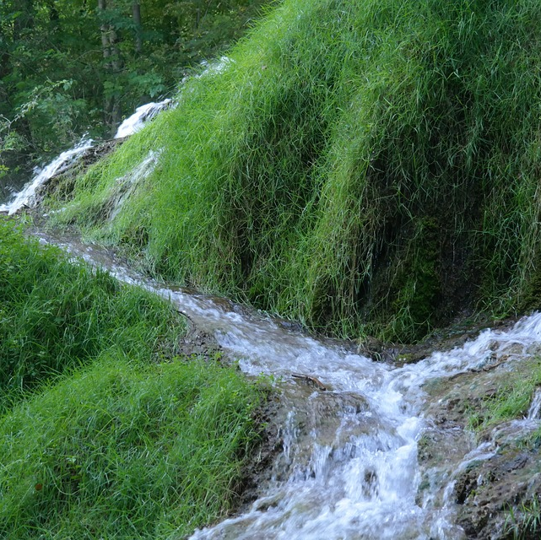
Issues to Watch for:
Language could be used to revisit stream flow regulations to 1) change release requirements; and/or 2) extend requirements to groundwater supplies.
Whether state agencies will use a collaborative process in revising water supply regulations to ensure appropriate balance of water uses,
Water utilities are currently developing comprehensive plans outlining the methods and locations to be used to calculate release flows and to demonstrate compliance with flow requirements, including modifying dams and distribution systems.
Modifying dams and distribution systems to make mandated stream flow releases is an enormous undertaking, requiring millions of $$ in infrastructure and operating costs.

Slide 8

State Bond Package
Includes funding for water and wastewater projects:
Clean Water Fund – Authorizes $133 million in FY26 and $175 million in FY27 for grants to assist municipalities in address water pollution. Also authorizes $50 million in FY26 and $500 million in FY27 for low interest loans to assist in addressing water pollution issues.
PFAS Remediation – Authorizes $5 million per year to assist municipalities in address PFAS contamination in soil and drinking water in addition to a $2 million unallocated balance.
Open Space & Watershed Land Acquisition Program – Authorizes funding of $10 million per year
  Application Deadline – November 3, 2025 – water companies are eligible

Slide 9
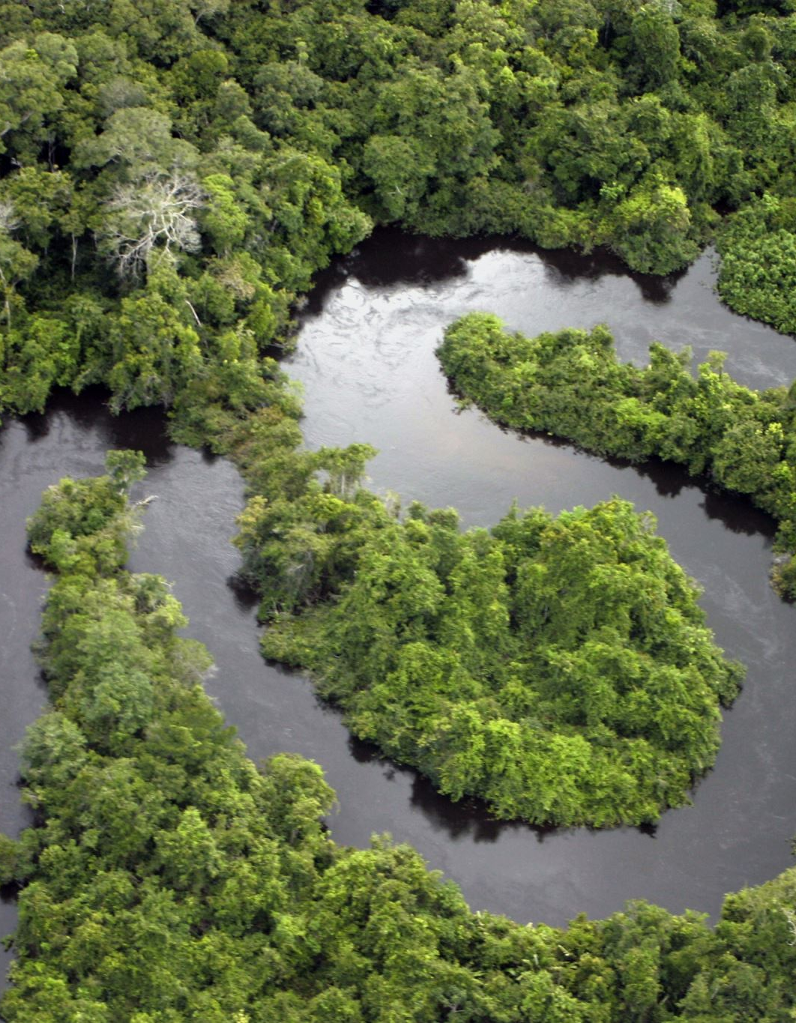
Riparian Buffers
PA 25-12 creates a working group to develop recommendations to broaden the applicability of the state’s Inland Wetlands and Watercourses Act (IWWA) to include the area immediately adjacent to and extending outward from a wetland or watercourse boundary by at least 100 feet (the “riparian area”).
Issues of Note for Water Companies – (1) Need to maintain the as-of-right exceptions for water utilities related to the construction and operation of dams, reservoirs and other facilities necessary to the impounding, storage and withdrawal of water in connection with public water supplies.
(2) How would expanding the authority of municipal inland wetlands agencies and DEEP to regulate activities in these areas, which generally entails reviewing proposals for activities, issuing permits, and conducting enforcement actions, affect water utility projects.

Slide 10

DPH Revisions to Drinking Water
PA 25-98 (HB-6978):
Provides for biennial license renewal for bulk water haulers
Allows DPH to adopt policies and procedures while in the process of adopting regulations concerning subsurface sewage disposal systems with a 10,000 gallon capacity;
Revises certain application requirements relating to the construction, expansion or utilization of new water supply sources to reflect current practices.
  As under existing law, it prohibits building, expanding, or using a public water system that provides drinking water without DPH’s approval and continues to require DPH to approve and issue permits for these systems.
  Applies this approval process to individuals, partnerships, associations, corporations, municipalities, or other entities or lessees of a public water system. (Currently, the process specifically applies to systems owned or used by water companies
  As under current law, no prior review or approval is needed for distribution water main installations if they are constructed according to sound engineering standards and all applicable laws and regulations.

Slide 11
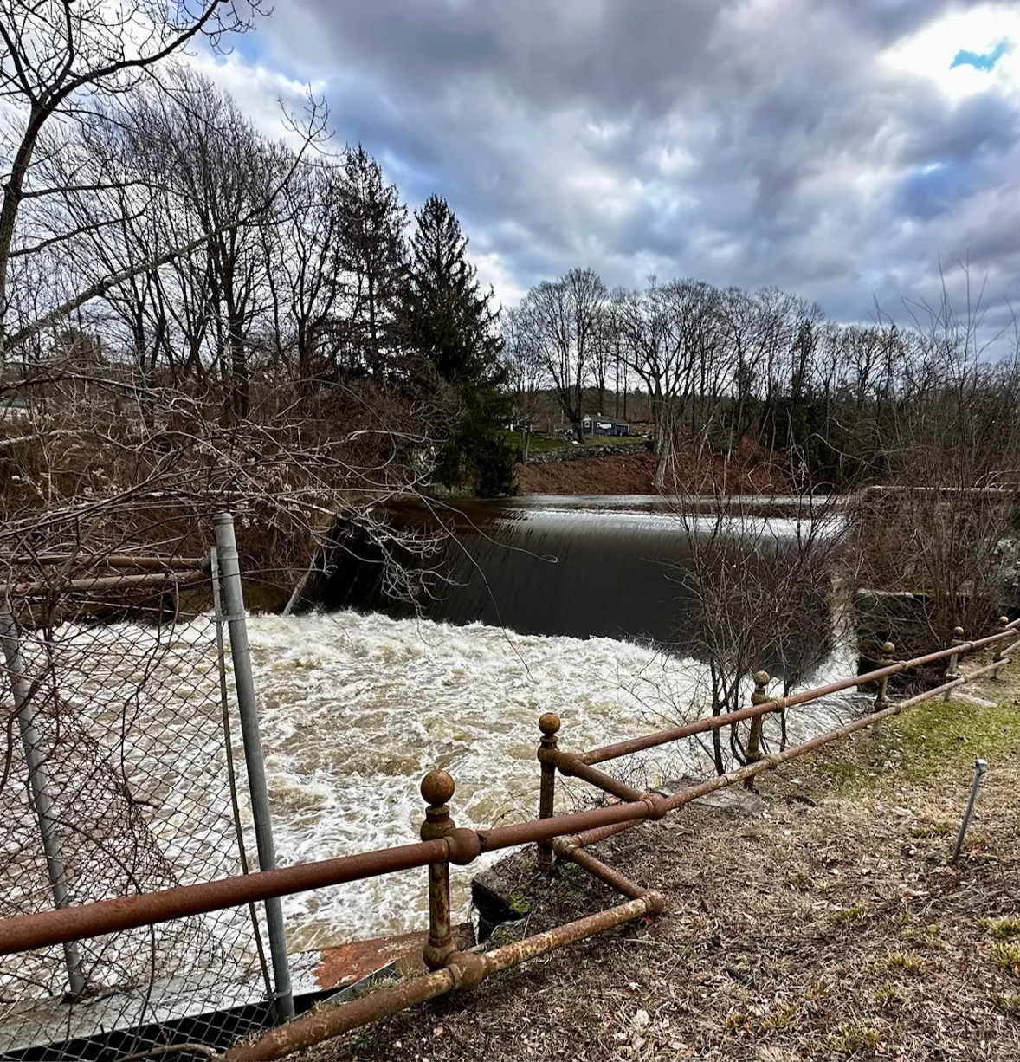
Environmental Permitting
Public Act 25-84 builds on DEEP’s 20 by 26 initiative:
Introduces procedural reforms to simplify petitioned hearings on DEEP licenses.
By reclassifying these as public informational sessions, the process becomes more accessible and less burdensome for parties, while still ensuring transparency and public input.
Additionally, the bill authorizes DEEP to:
1. Require “watershed-level compensatory mitigation” (i.e.
compensation to offset impacts to water resources) for certain
regulated activities, and
2. Extend a general permit’s expiration date until a new permit is
issued, or until DEEP declines to issue a new permit, rather than
extend them for one year past the expiration date as current law
allows.

Slide 12

Training – Inland Wetland Agencies
Public Act 25-73 includes provisions requiring members and employees of inland wetland agencies on January 1, 2026, to complete their initial training within one year from that date.
Individuals elected, hired, or appointed to serve after that date must complete the training within one year after their appointment, election, or hire.
All members and employees must retrain every four years or once per term (for elected or appointed members), whichever is less frequent.
Online training is available for free from DEEP.
Opportunity to ensure that training touches on issues related to source water protection…

Slide 13

Fluoride
PA 25-168 (SB-7) requires water companies that serve 20,000 or more persons to add fluoride to the water supply to maintain an average monthly fluoride content of 0.7 of a milligram per liter, provided the average monthly fluoride content shall not deviate greater or less than 0.15 of a milligram per liter.
This Photo by Unknown Author is licensed under CC BY

Slide 14

Big Energy Bill – Restoration Plan
PA 25-173 requires all public service companies and municipal water utilities to establish an emergency service restoration planning committee to prepare a restoration plan. By law, the plan generally includes ways to communicate and coordinate with officials and participate in training exercises. The minutes of such committee meetings must be submitted to PURA and the Dept. of Emergency Services & Public Protection upon request.
Maintains the exemption from filing an emergency plan for water utilities required to file a water supply plan.

Slide 15

Big Energy Bill – Low Income Rates
Establishes cost containment measures that PURA must implement when setting low-income rates in certain rate cases and other proceedings. These measures include:
1. a usage cap for customers receiving a low-income discount rate (based on gallons for water company customers);
2. a PURA review that is triggered if an EDC’s, gas company’s, or water company’s total costs to fund the low-income rate exceed a certain percentage of its annual billed total revenues; and
3. a recertification process to confirm, at least every 12 months, income eligibility and appropriate tier placement.
Under the act, these cost containment measures must be applied to low-income rates set in (1) rate cases or other proceedings initiated on or after October 1, 2025, and (2) pending cases for which a final decision has not been issued by November 1, 2025.
The act also requires the PURA chairperson to report on (1) low-income rates implemented from January 1, 2024, to December 31, 2028.

Slide 16

Big Energy Bill- PURA/DEEP
The act changes the relationship between two energy related agencies by placing PURA within DEEP for administrative purposes only.
Among other things, this explicitly allows PURA to exercise its regulatory authority without DEEP’s approval or control.
The act also makes changes related to:
(1) commissioner terms;
(2) decisions, requiring votes be put into writing and posted on PURA’s website;
(3) panels (e.g., requiring rate adjustment proceedings be before all commissioners, rather than a panel of them); and
(4) employment restrictions (e.g., expanding “revolving door” restrictions limiting post-PURA employment and appearances before it).
Effective October 1, 2025.

Slide 17

Big Energy Bill- Agency Consultants
Under existing law, DEEP and PURA are authorized to retain consultants for certain federal proceedings, but only in consultation with other state agencies and, for PURA, only for proceedings for one federal agency.
A new law broadens this authorization, allowing DEEP, PURA, and the Office of Consumer Counsel (OCC) to independently retain consultants for proceedings or negotiations with various federal agencies (e.g., FERC, U.S. Department of Energy, U.S. Nuclear Regulatory Commission, among others).
Such consultant costs are borne by the utilities subject to the proceedings.
Effective Date: October 1, 2025.

Slide 18

Unpaid Sewer Assessments
PA 25-150 prohibits the following actions on owner-occupied properties unless a lien’s principal amount exceeds $3,000 or three years have passed since the lien was filed and it remains unpaid:
1. municipal or regional WPCAs foreclosing liens for delinquent sewer assessments or connection or use charges;
2. regional WPCAs instituting a civil action to enforce liens for delinquent sewer assessments or connection or use charges; and
3. municipal or regional WPCAs or regional sewer authorities assigning liens for delinquent assessments or use charges.
The act’s restrictions do not apply to sewer lien (1) foreclosures if they are foreclosed in an action involving tax or other municipal liens and (2) assignments if tax or other municipal liens on the property are currently assigned or are being assigned at the same time.

Slide 19

Cybersecurity
Drones – Public Act 25-1 generally prohibits, beginning on varying dates, state agencies, municipalities, and those who contract with either from purchasing or using certain drones assembled or manufactured by a covered foreign entity (e.g., China or Russia)
It also prohibits, with certain exceptions, (1) operating drones in close proximity to critical infrastructure facilities or to surveil these facilities or (2) equipping an aircraft or drone with a deadly weapon or certain other dangerous devices
Municipal .Gov Websites – PA 25-44 includes provisions requiring municipalities to move websites to a .gov domain by July 1, 2027 to provide greater cybersecurity protection.

Slide 20
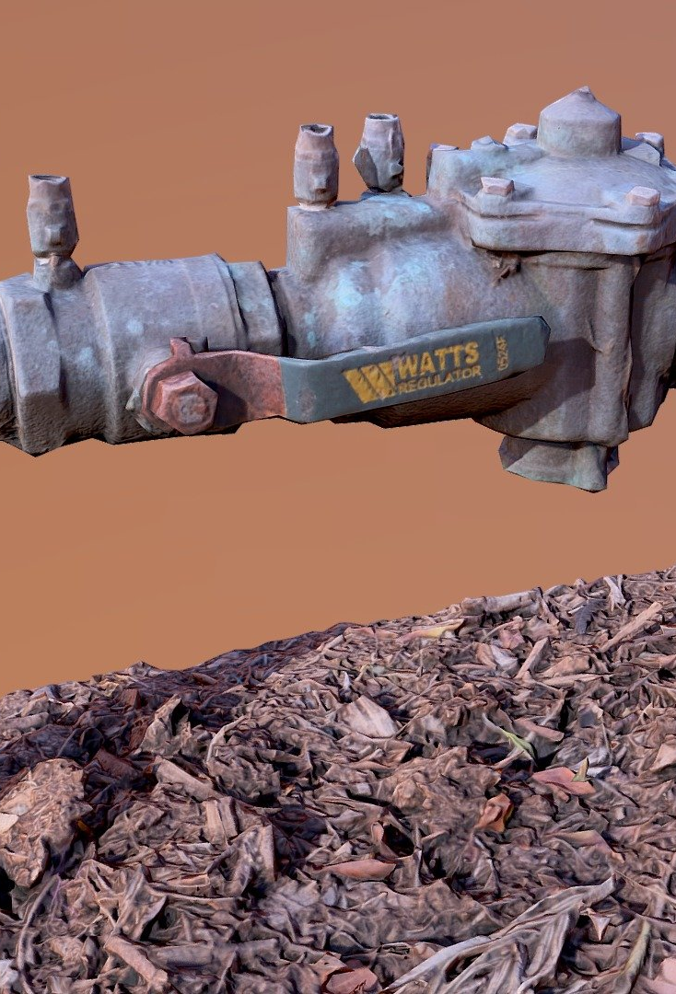
Cross Connections
Need to update the cross connections manual and regulations to protect the safety and quality of drinking water.
The regulations have not been updated since 2008 and do not reflect changes in plumbing systems and equipment or newer practices that may involve potential cross connection contamination issues.

Slide 21

PFAS Testing & Remediation
Although a bill did not pass in 2025, given some uncertainty regarding what is happening on the federal level, the state legislature may want to codify requirements relative to PFAS testing and remediation.
A bill under consideration last session would have accelerated testing requirements and set limits at 20 parts per trillion.

Slide 22

Housing Development – Sewage Disposal
PA 25-97 establishes a working group to assess and make recommendations on:
regulatory requirements for sewage disposal, including nitrogen discharge limits and their impact on housing development, public health, and the environment, and
balancing the costs of housing development and a risk-based approach to protecting public health and the environment.
Under the act, the working group chairperson must report the group’s assessment and recommendations to the DPH commissioner and the Environment, Housing, and Public Health committees by February 1, 2026.

Slide 23

Housing Development – Public Infrastructure
A bill that is expected to be considered in special session this year will require OPM to develop and administer a housing growth program to provide grants-in-aid to assist municipalities in paying costs related to the construction, improvement and expansion of public infrastructure, including, but not limited to, water lines, sewer lines, roads, bicycle and pedestrian and transit infrastructure associated with the implementation of housing growth policies.
Housing growth policies include efforts to revise zoning laws to support affordable housing development.

Slide 24

Housing Issues – Wastewater Capacity
The housing bill is also expected to require OPM, within available appropriations and in coordination with the interagency council on housing development, to conduct a state-wide wastewater capacity study that evaluates the capacity, flows, physical conditions, regulatory compliance and vulnerabilities to natural hazards of publicly and privately owned wastewater infrastructure.
In conducting the study, OPM shall identify areas underserved by wastewater infrastructure and existing wastewater capacity limitations and make recommendations for efficient investments in wastewater infrastructure to support housing and economic development while protecting public and environmental health
OPM will also be required to identify areas with excess wastewater capacity.

Slide 25
Thank you!

