Slide 1
Implementing Lead Service Line Replacement Programs
Sarah DeMezzo
GIS Manager
sdemezzo@aquarionwater.com

Slide 2
Outline
The Inventory
Funding
Our LSL Replacement Program
Communications
Lessons Learned

Slide 3
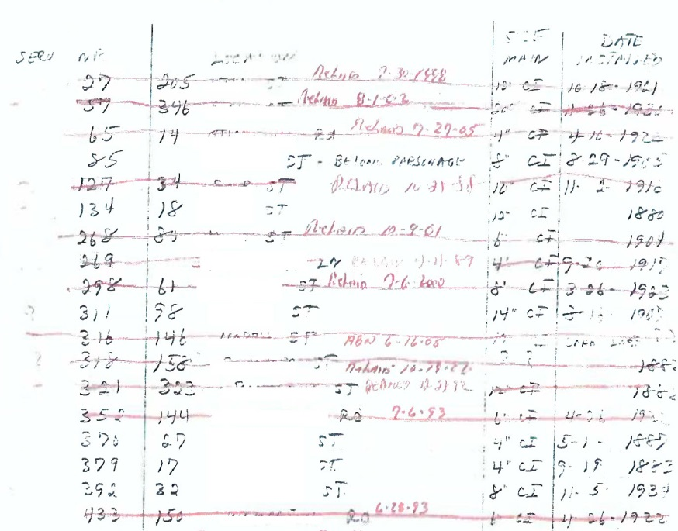
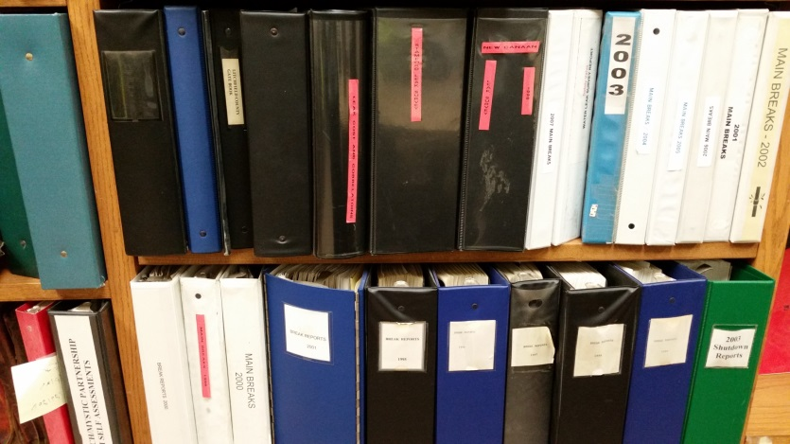
Inventory Creation
Data is in many forms
  Digital
  Notebooks
  Binders
  Maps with mark-ups
  Sheets of paper
  Spreadsheets

Slide 4
Collect and Review Existing Data
  Digital tapcard
  Physical tapcard
  Annual reports
  Existing lead service pipe inventory
  Water system mapping and installation dates
  Customer database
  Maintenance records
  Construction records
  Retired staff assistance
  Vacuum Excavations
  Customer Self Reporting
  Basement Inspections

Slide 6
Inventory Lessons Learned
SOP's for recording service line materials
Create service line material guides for new employees
Revisit data after a few months to ensure everyone is onboard
Automate as much as possible

Slide 7
Funding
DWSRF
Received:
$4.4 million for inventory
$1.8 million for replacements
Applied for:
$3.1 million for inventory
$2.7 million for replacements

Slide 8
Lead Service Line Replacements (LSLR)
Planning
  Coordinate with town paving programs to replace lead service lines prior to the town and other utilities coming in.
  Start with areas where the town has not been in the last ten years. Easier to know where they have been then where they are going.
  Coordinate with main replacement & service replacements programs.
Budgeting
  13 year budget (how many per year would we have to replace).

Slide 9
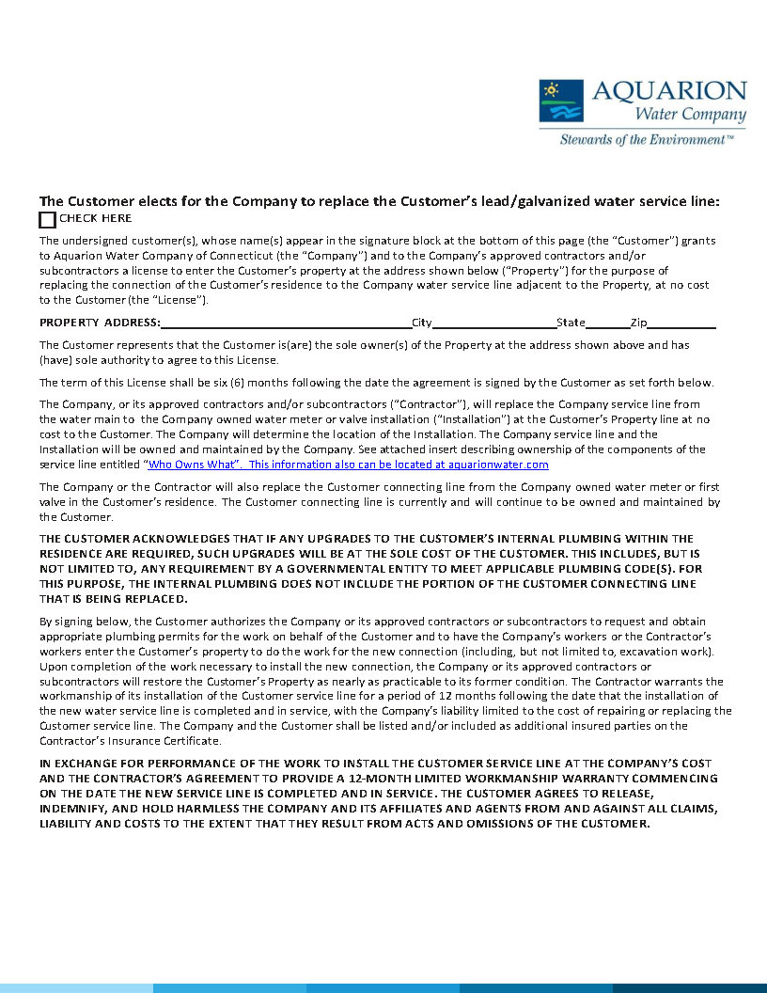
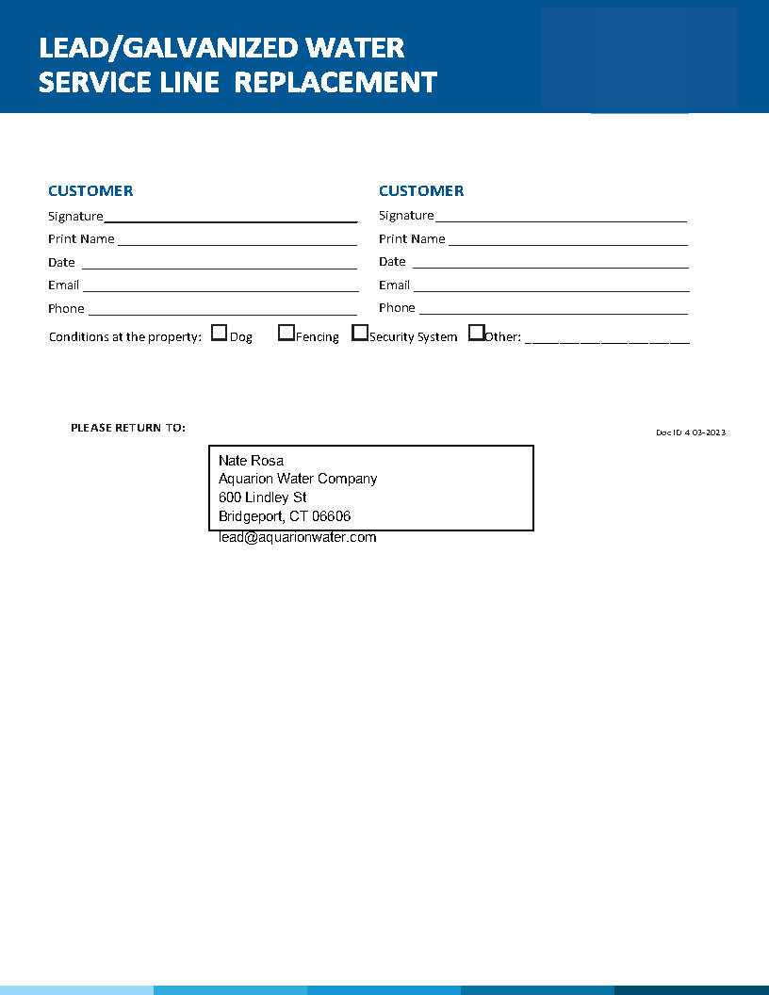

Slide 10
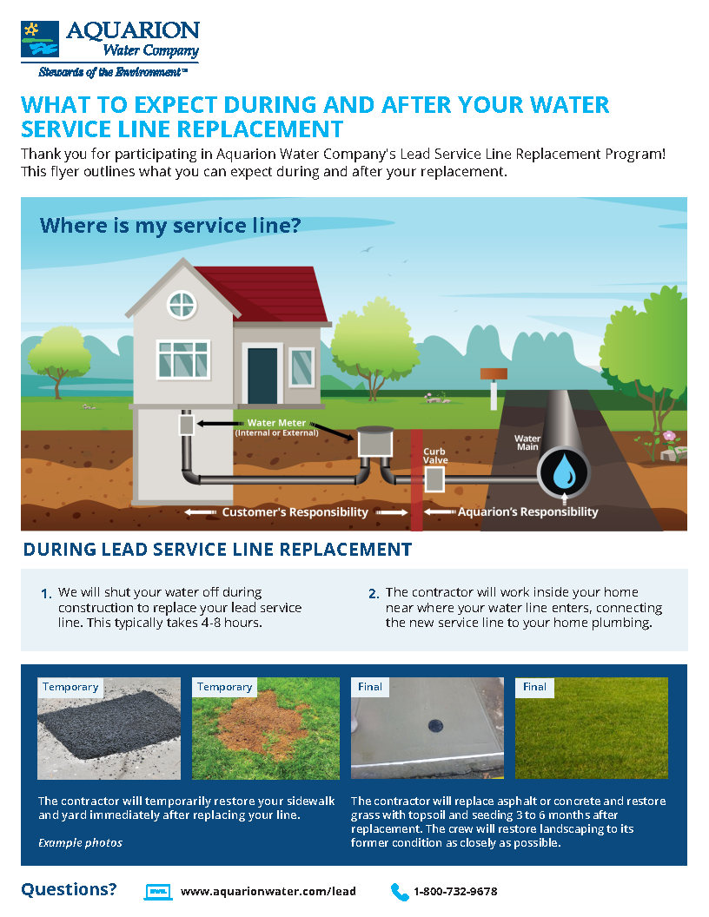
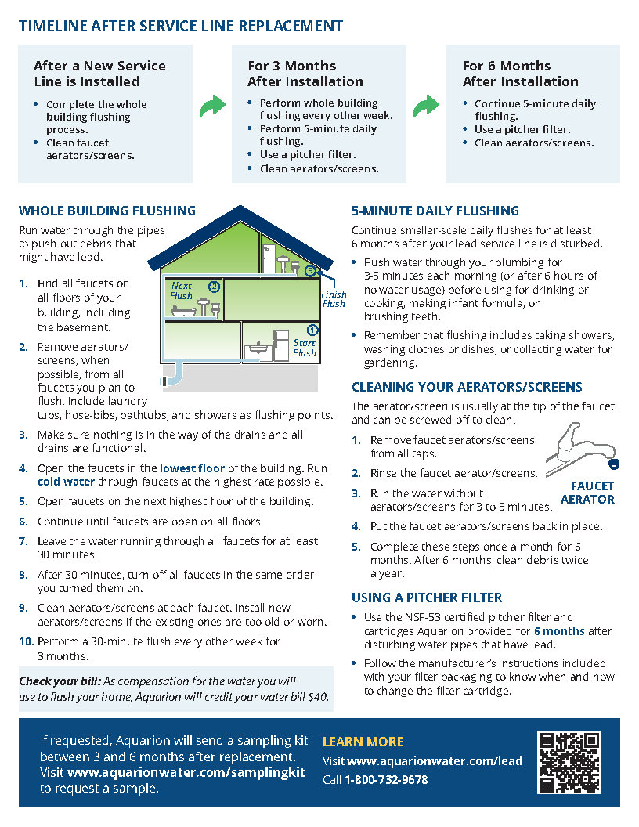

Slide 11
Lead Service Line Replacements
If seeking funding hire someone to manage the "paperwork"
Due Diligence in the field will save you tie and money in the long run.
Set expectations of the contractors early and often
SOP's for staff and contractors

