Slide 1
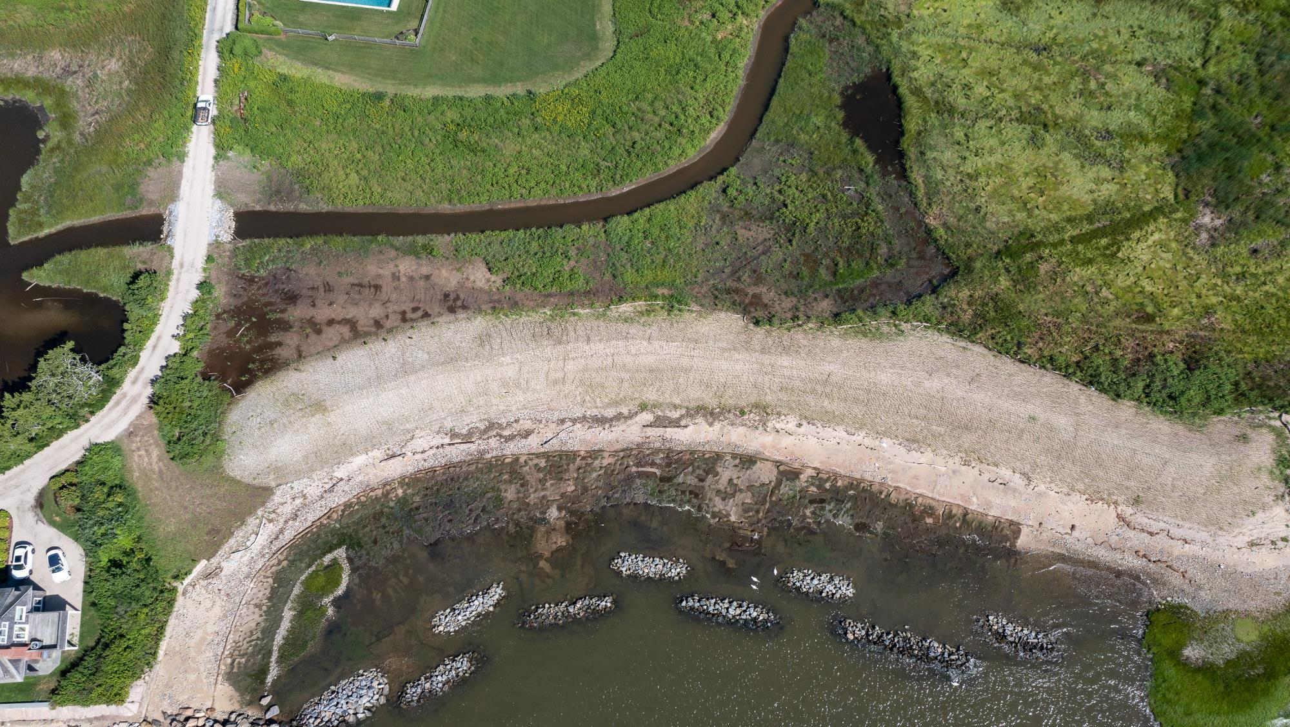


  CWWA/CTAWWA Fall Conference
  October 17, 2024
  Living Shorelines and Nature-based Solutions

Slide 2




Design With Nature Studio Coastal Resilience Leaders
Wayne Cobleigh, CPSM
Vice President
wayne.cobleigh@gza.com
Stephen Lecco, AICP, CEP, PWS
Associate Principal
stephen.lecco@gza.com
Jay Womack, ASLA, LEED AP, WEDG
Landscape Architect | Ecological Design
jay.womack@gza.com
Dan Veriotti, P.E.
Associate Principal
dan.veriotti@gza.com

Slide 3
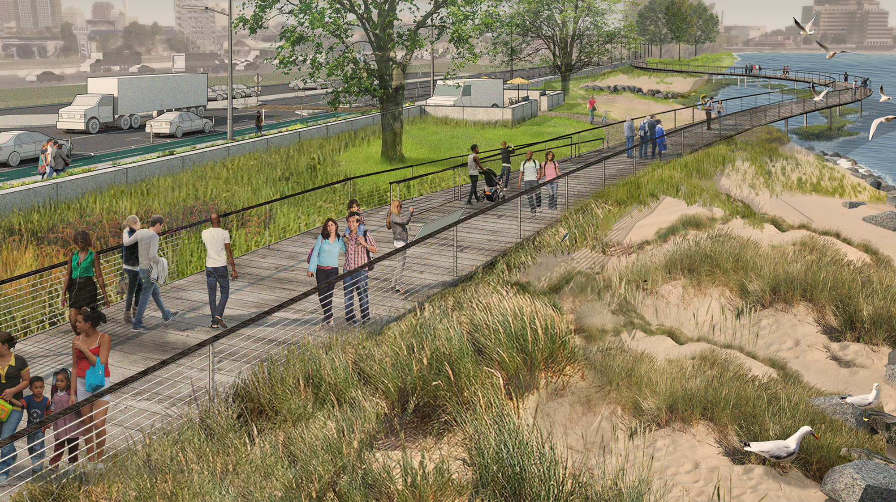
Long Wharf Flood Protection Rendering New Haven, CT (2015)

Slide 4
The Living Shoreline work supports GZA’s Design with Nature philosophy. It's how we think, plan, engineer, and design. GZA is committed to the application of natural and nature-based features to meet our Client's needs and challenges.
Design With Nature: Coastal Resilience Services:
Coastal Processes:
  Metocean Data Analysis
  Coastal Geomorphology and Processes
  Numerical Circulation, Wave and Sediment Transport Modeling
Coastal Resilience and Adaptation:
  Coastal Resilience and Climate Adaptation Plans
  Shoreline Management using NNBFs
  Living Shorelines
  Beach Nourishment
  Estuary and Tidal Marsh Restoration
  Bluff Stabilization
Ecology:
Wetlands Mapping
Essential Fish Habitat Analysis
Endangered and Rare Species Surveys
Engineering and Design:
Site/Civil Engineering
Tidal Inlet and Culvert Design
Landscape Architecture
Project Plans and Specifications
Construction Support
Environmental Permitting

Slide 5
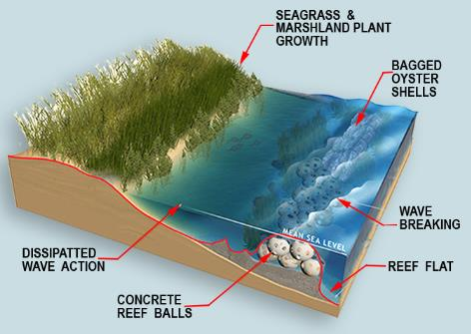
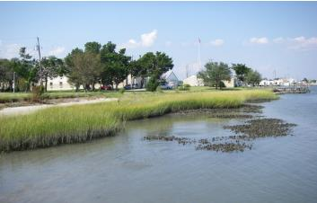
What is a Living Shoreline?
Living shorelines use plants or other natural elements — sometimes in combination with harder shoreline structures — to stabilize estuarine coasts, bays, and tributaries. (NOAA)
Typical components:
Wave attenuation devices (sills)
Sediment subgrade
New marsh (low and high)
Integration with beach and dune

Slide 6
Living Shoreline Engineering and Design Approach Involves:
Purpose
and Objectives
Concept
Design
Plans
Permits
Monitoring
Site
Characterization
Regulatory
Compliance
Performance Evaluation
Constructability Analysis
Develop Capture
Team & Plan
Bullet
Bullet
Bullet
SWOT
More…

Slide 7
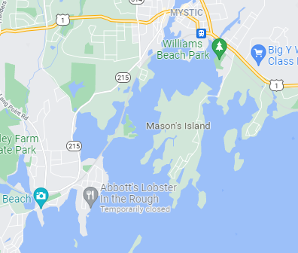
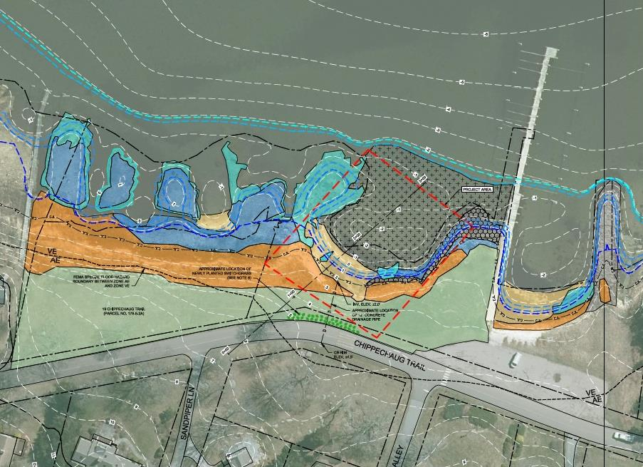
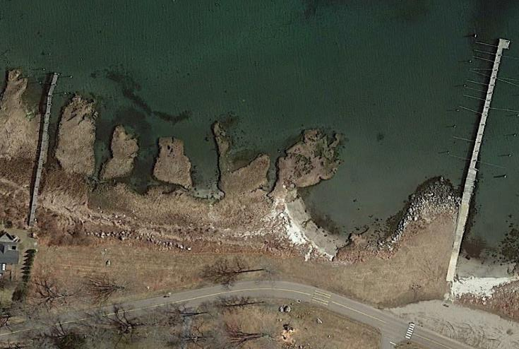
GZA Living Shoreline Experience
Mason’s Island Living Shoreline
(Under Design)
Mystic, Connecticut
Living Shoreline

Slide 8
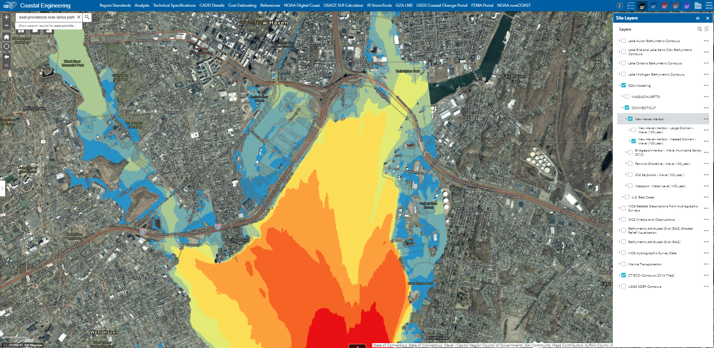
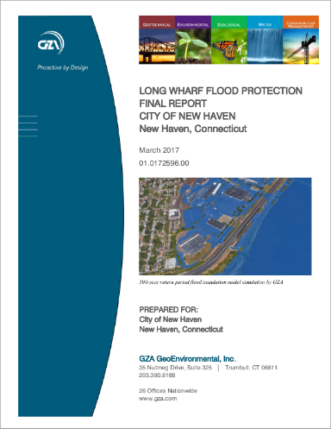
GZA Long Wharf Flood Study, New Haven, CT

Slide 9
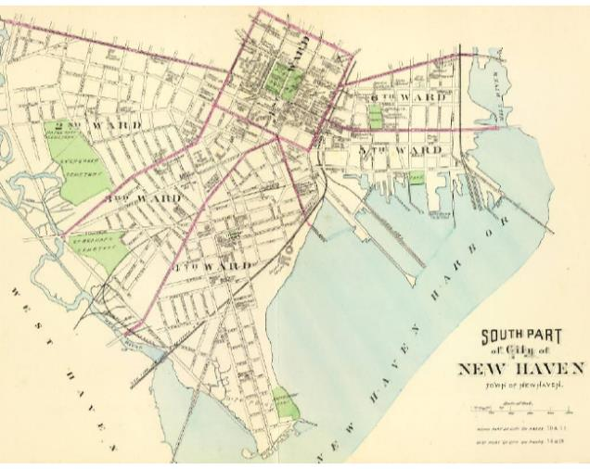
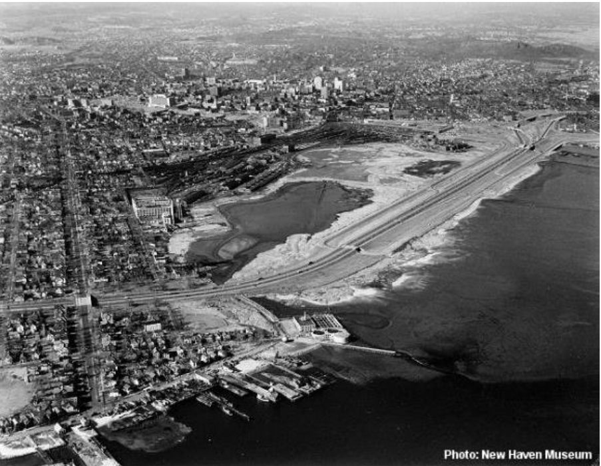

Slide 10
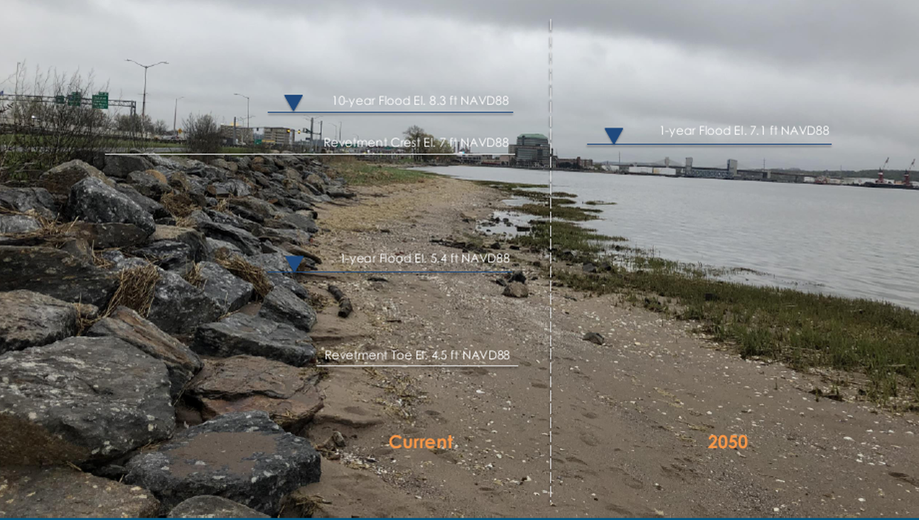

GZA Long Wharf Flood Study, New Haven, CT

Slide 11
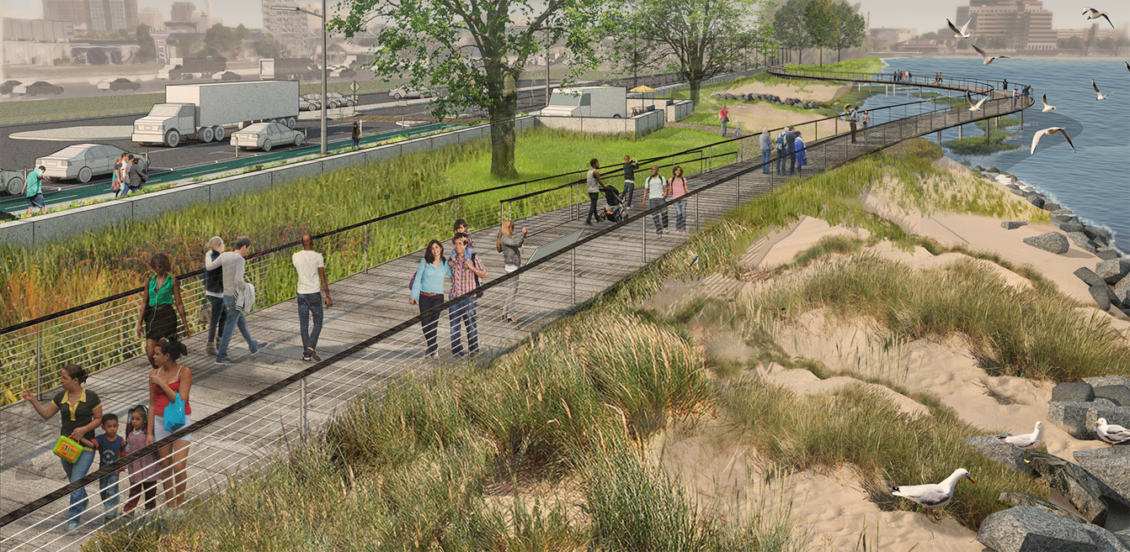
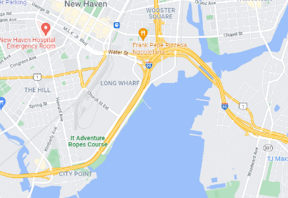
GZA Living Shoreline Experience
Long Wharf Living Shoreline (Permitted 2024)
New Haven, Connecticut
Urban Living Shoreline

Slide 12
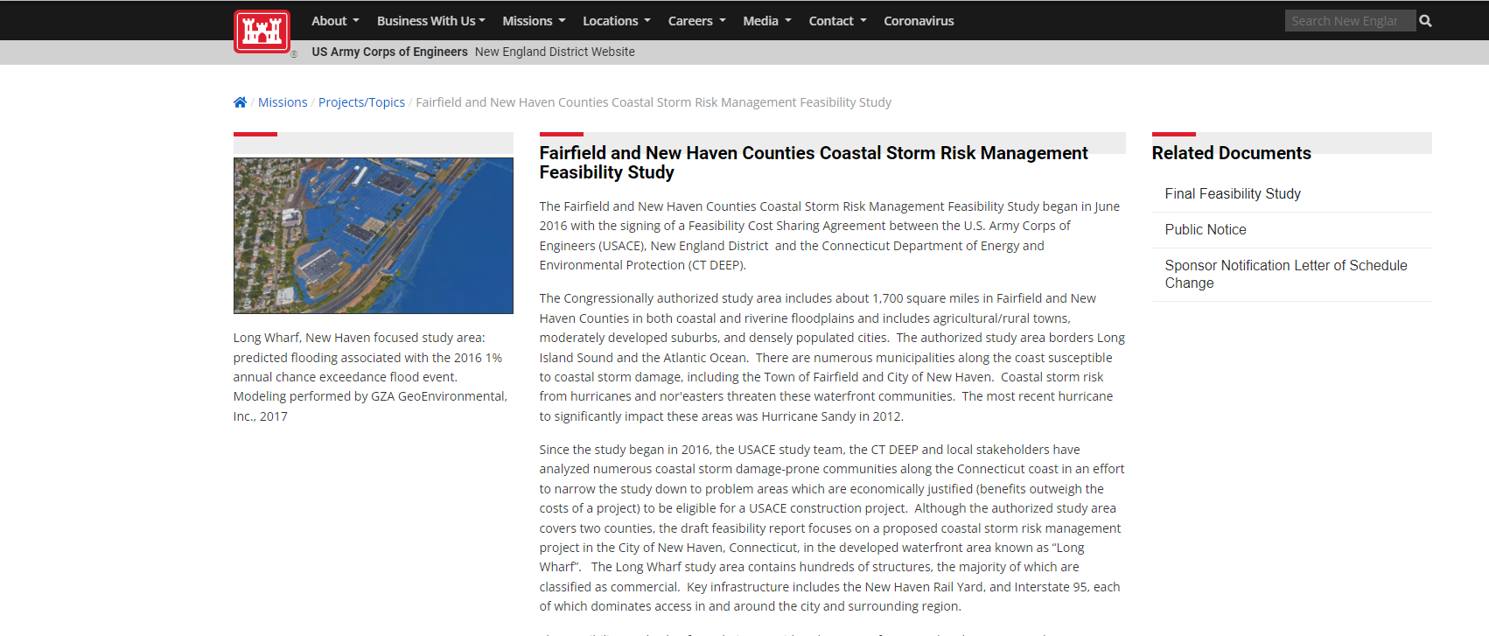
GZA Long Wharf Flood Study – USACE Reformulation Program

Slide 13
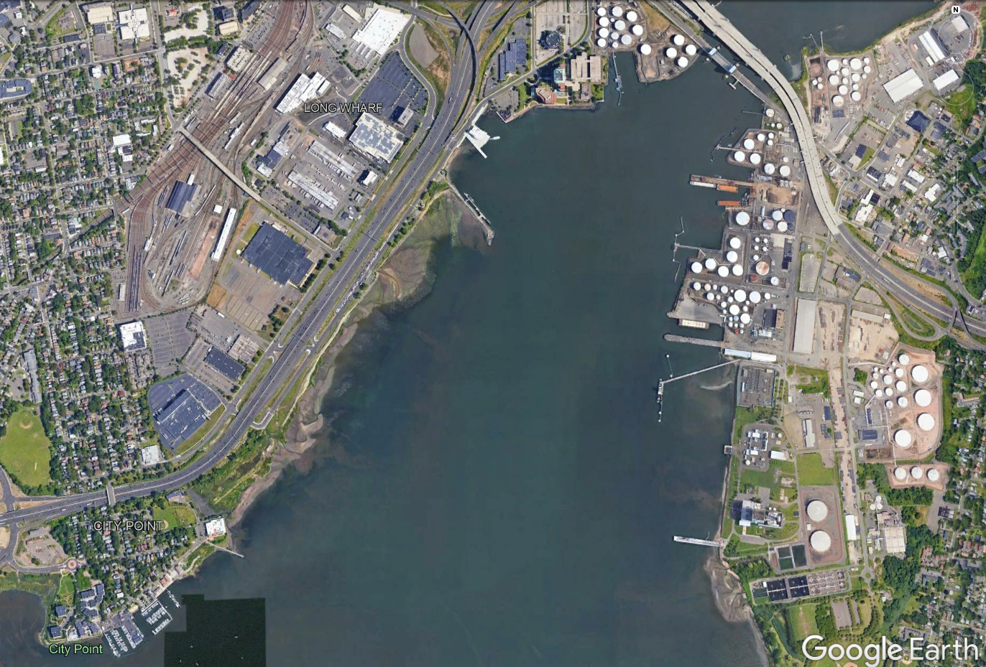
Maritime Center
Canal Boat House
Long Wharf Pier
Approx. 3500 FT
Living Shoreline
USACE Proposed Flood Protection System
Nature Preserve
City Point and Aquaculture School

Slide 14
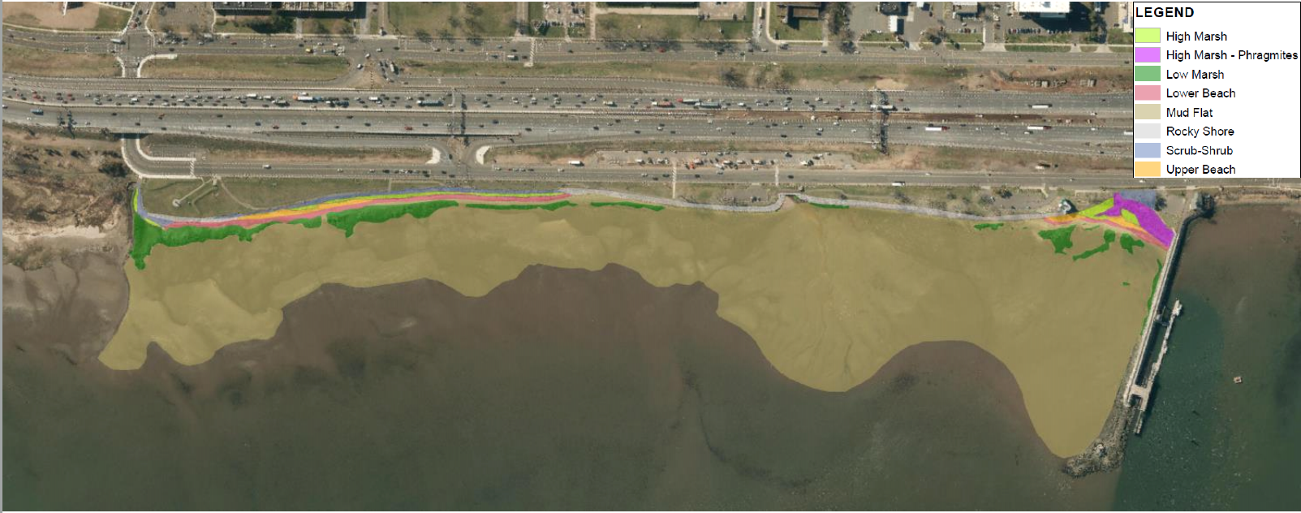
Existing Habitat

Slide 15
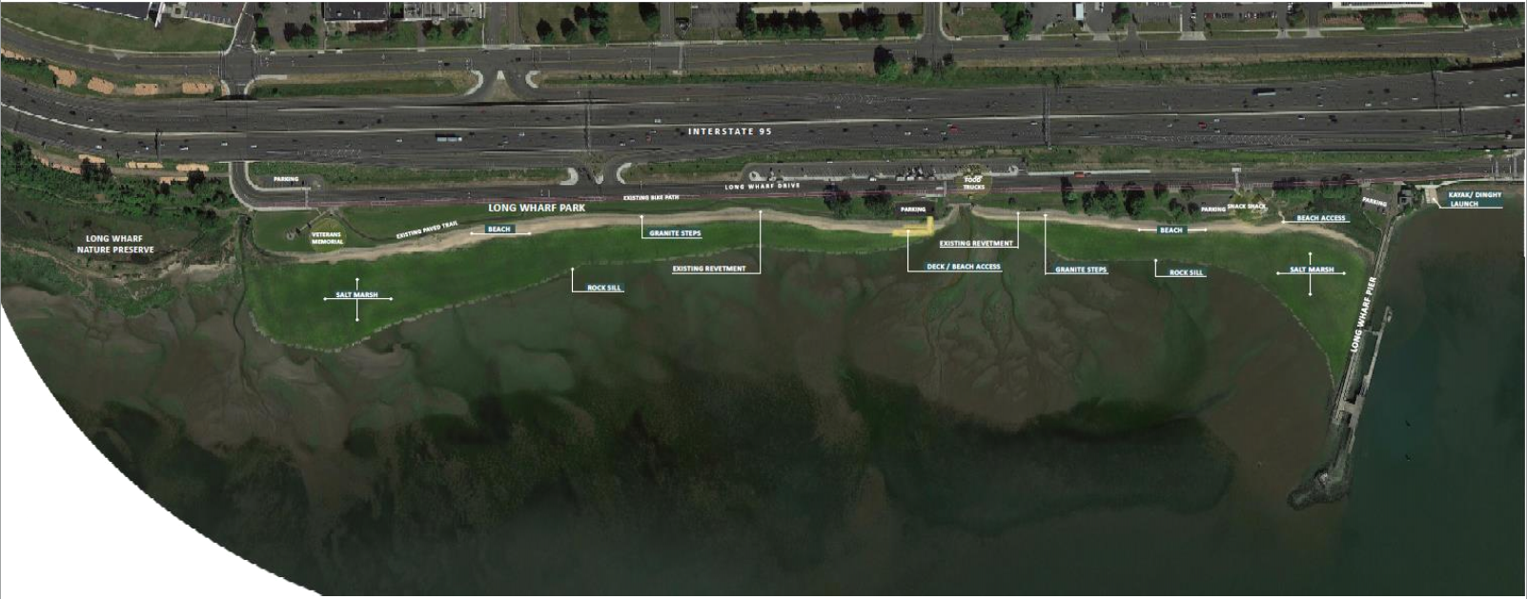
Living Shoreline Concept

Slide 16
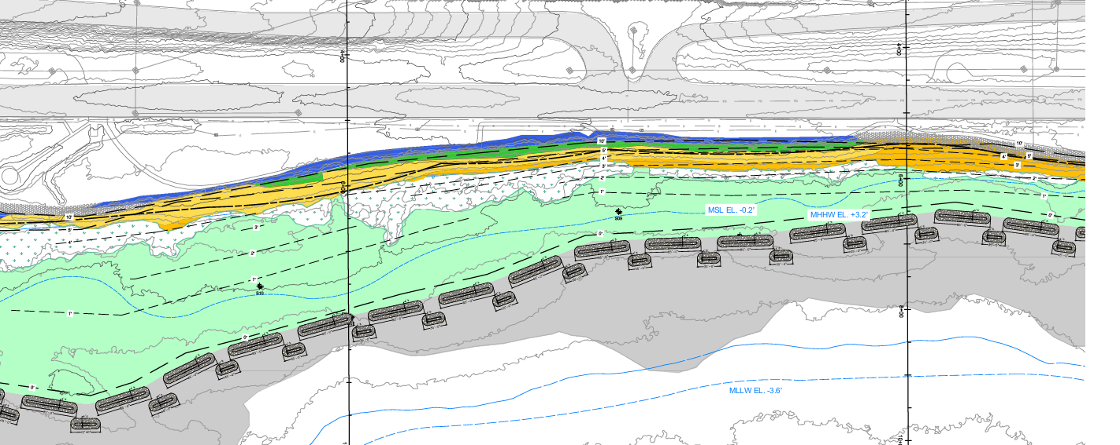
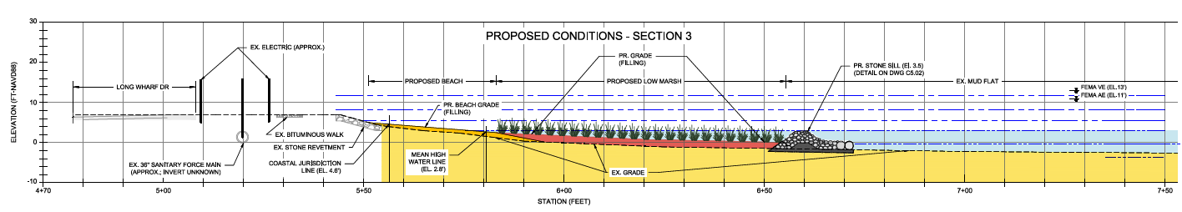
Long Wharf Living Shoreline Design

Slide 17
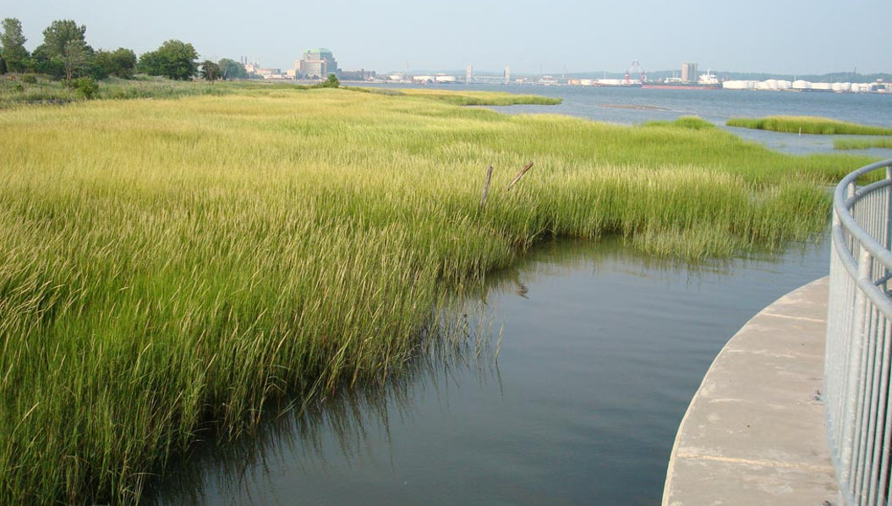
Inspiration for Long Wharf Living Shoreline Design

Slide 18
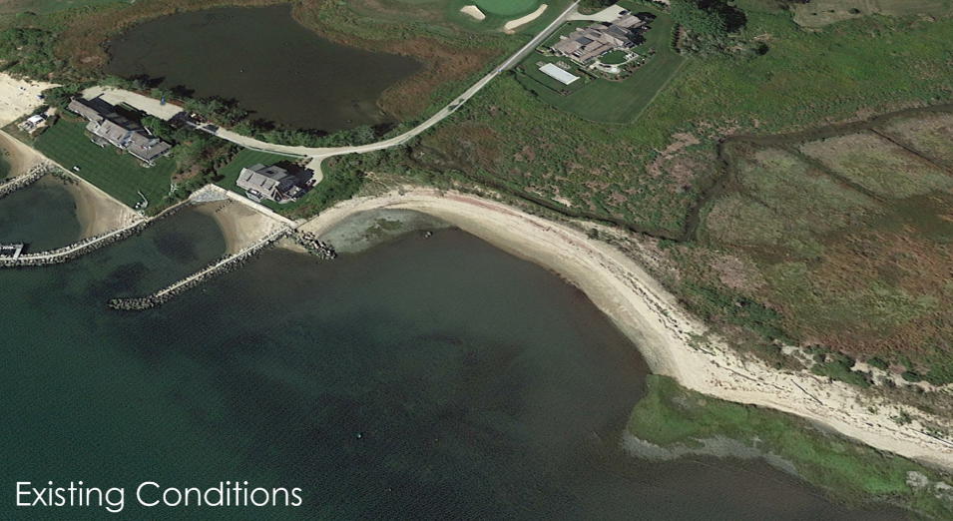
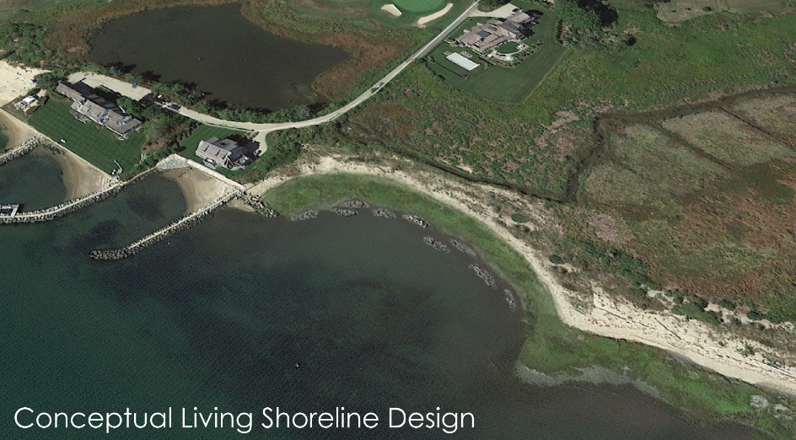
GZA Living Shoreline Experience
Hepburn Beach Living Shoreline (Constructed)
Borough of Fenwick, Old Saybrook, CT
Connecticut Pilot Project

Slide 19
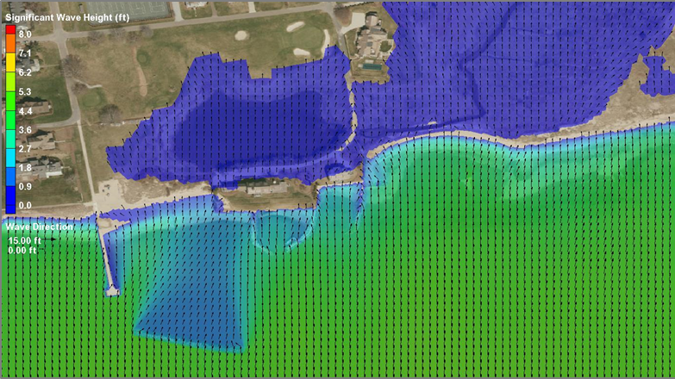

Visualization using numerical modeling – Hepburn Living Shoreline

Slide 20
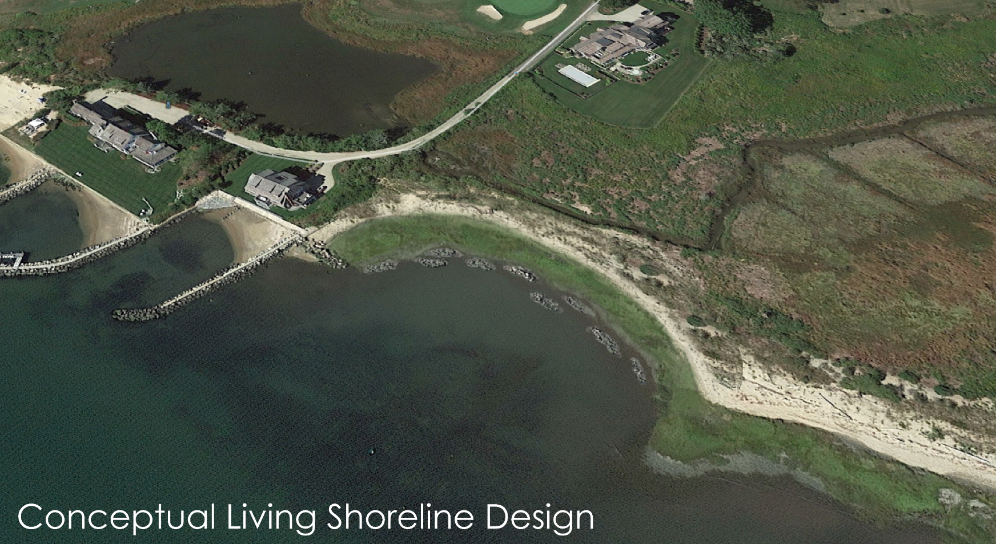

Visualization to Better Understand the Completed Living Shoreline Landscape

Slide 21
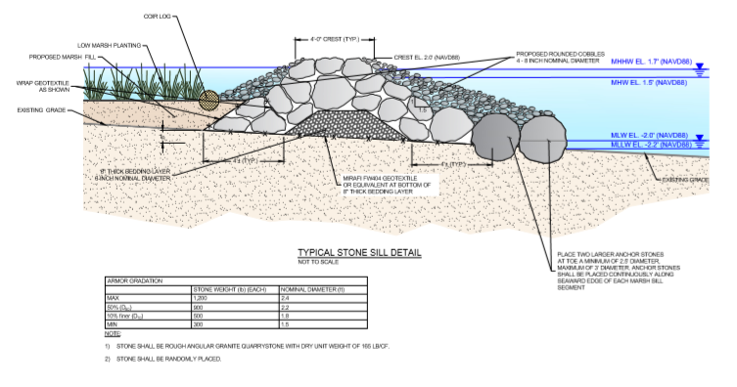
Importance of Visualizing Details – Living Shoreline “Drawn to Scale”

Slide 22
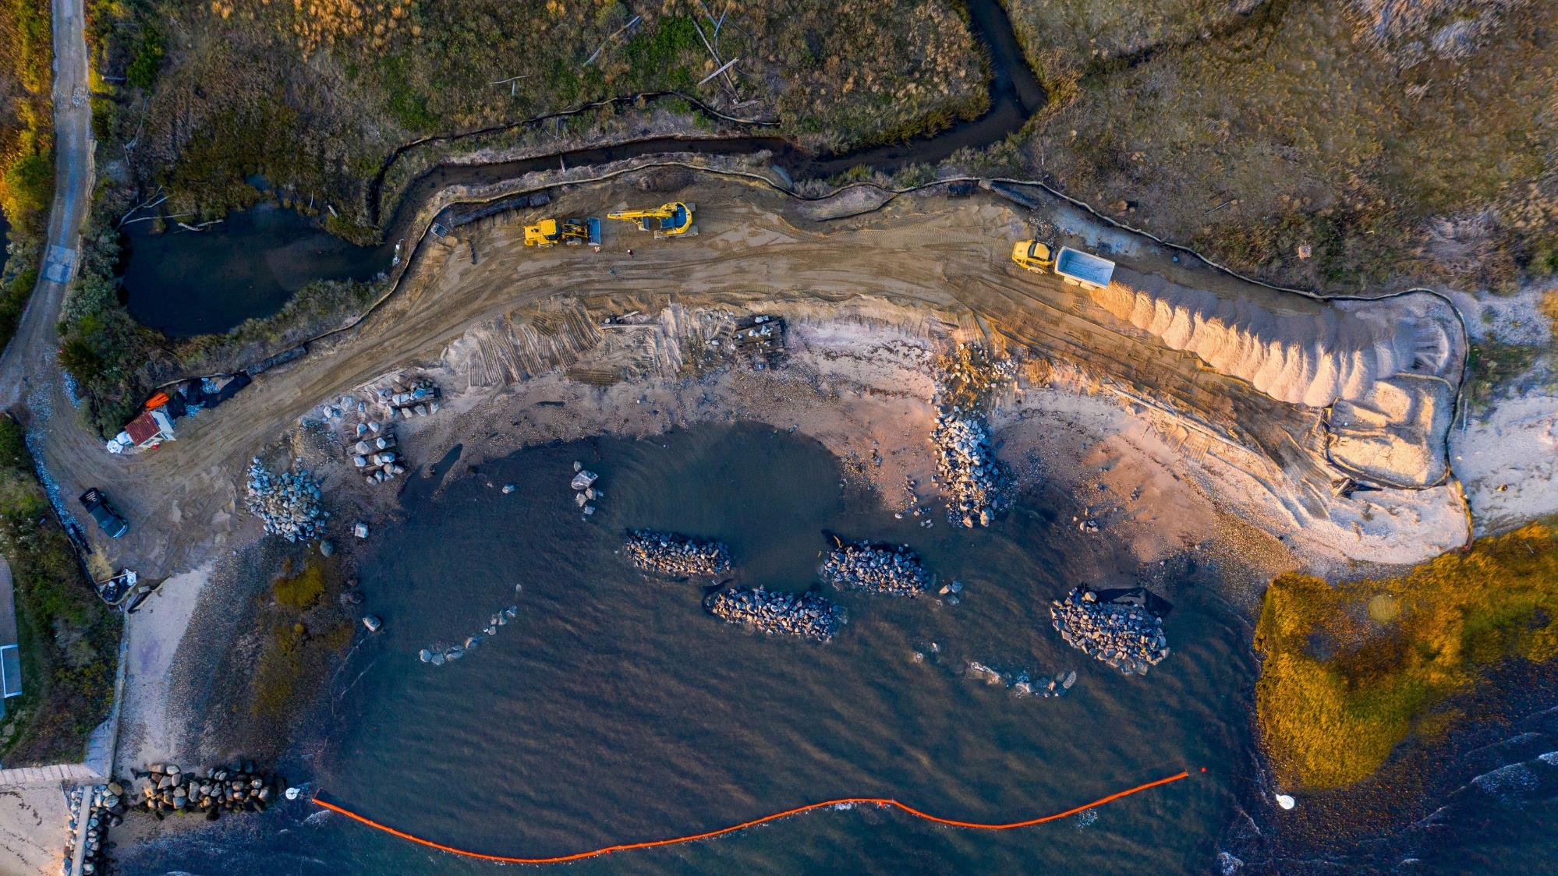

Slide 23
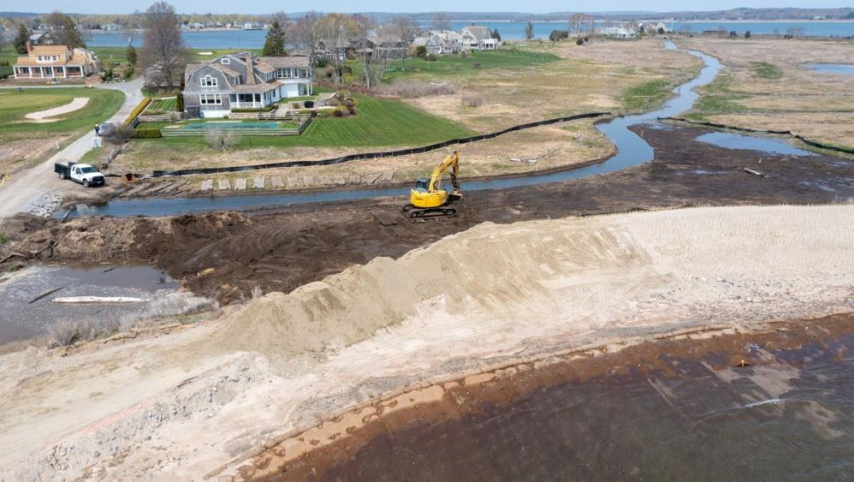

Slide 24
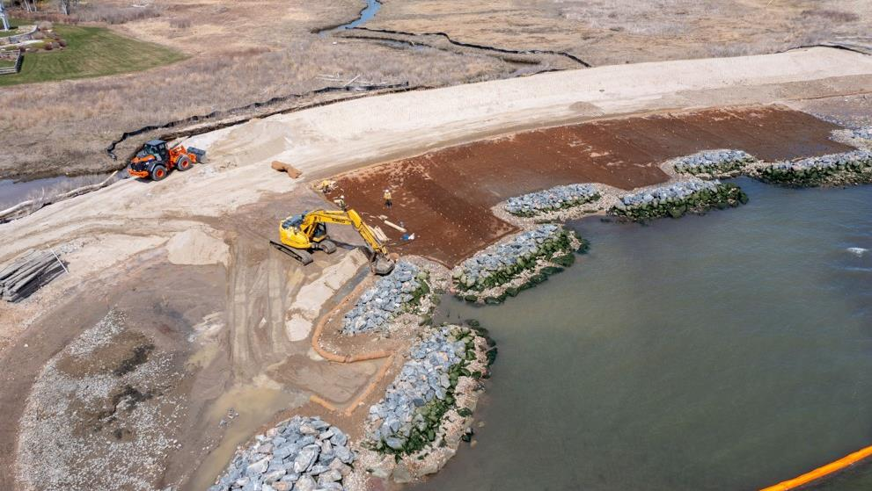

Slide 25
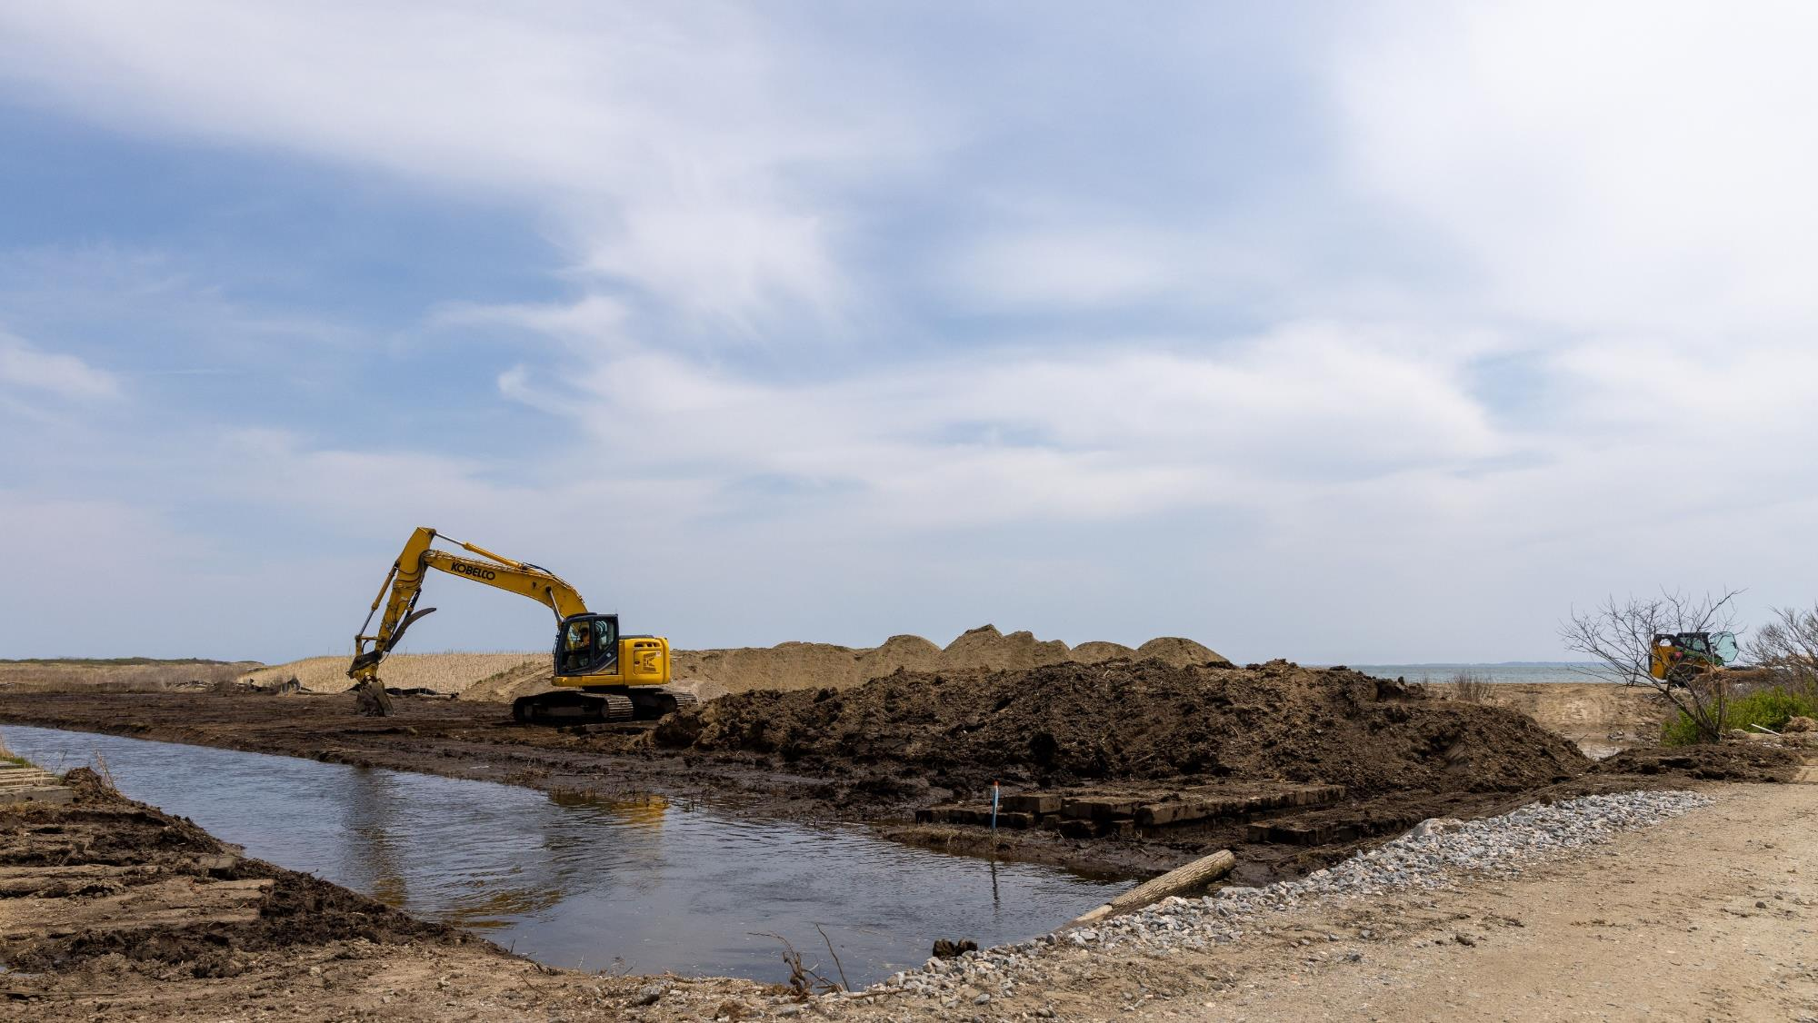

Slide 26
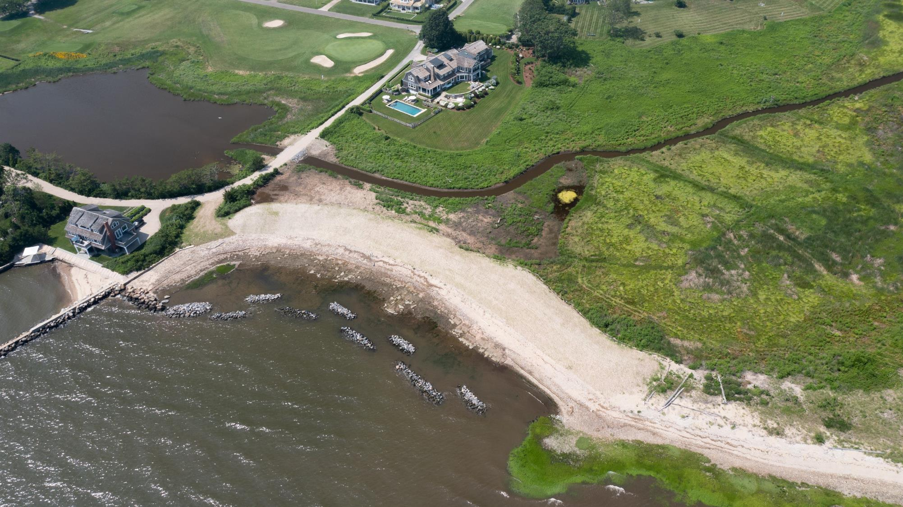

Slide 27
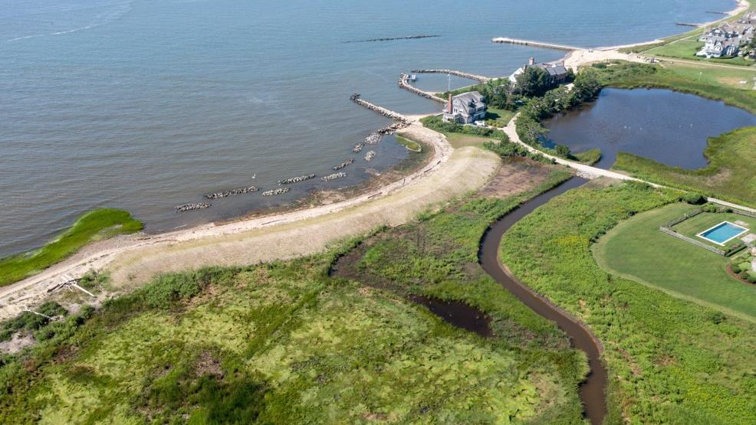
AUGUST 2021

Slide 28
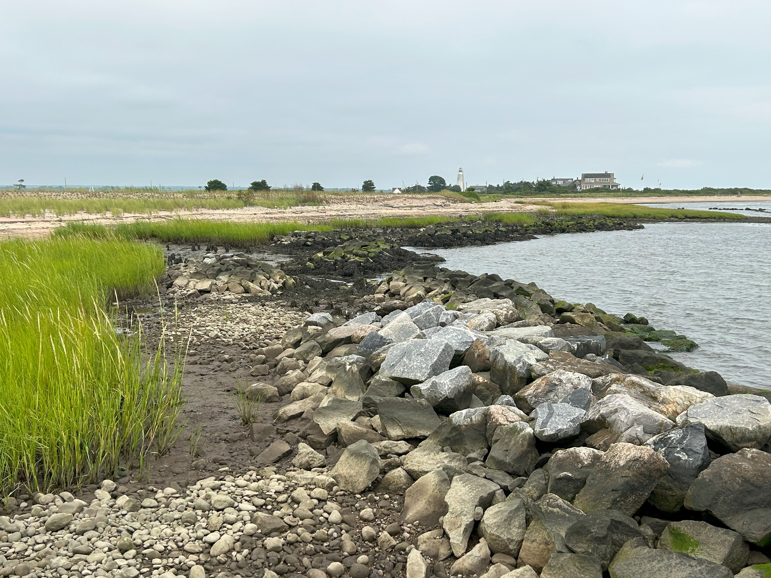
AUGUST 2024

Slide 29
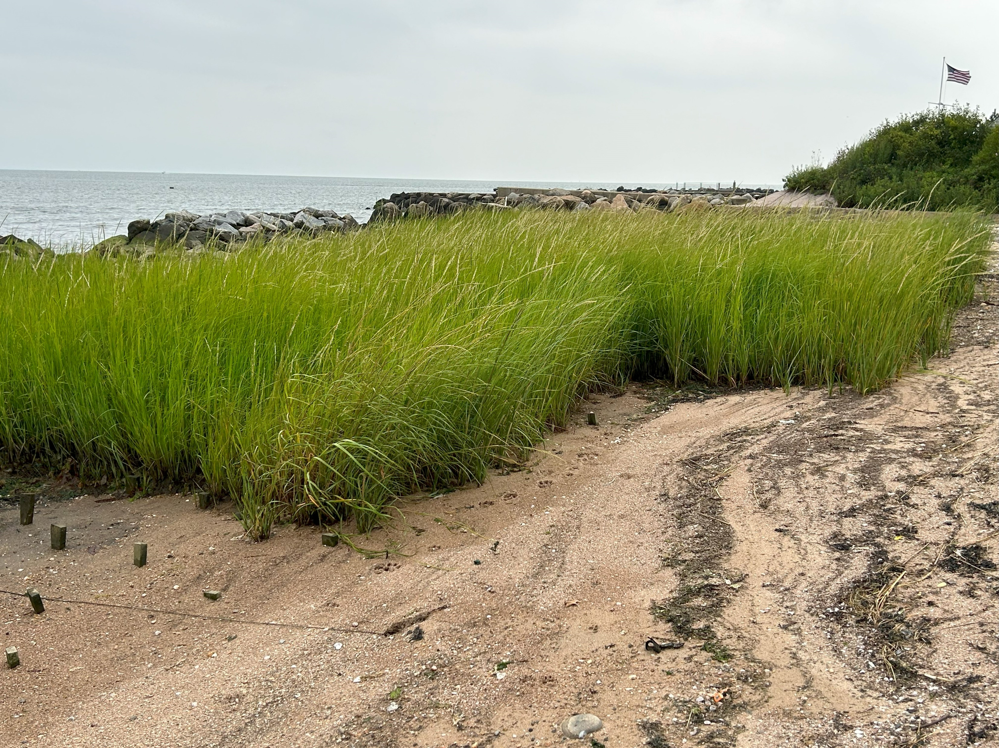
AUGUST 2024

Slide 30
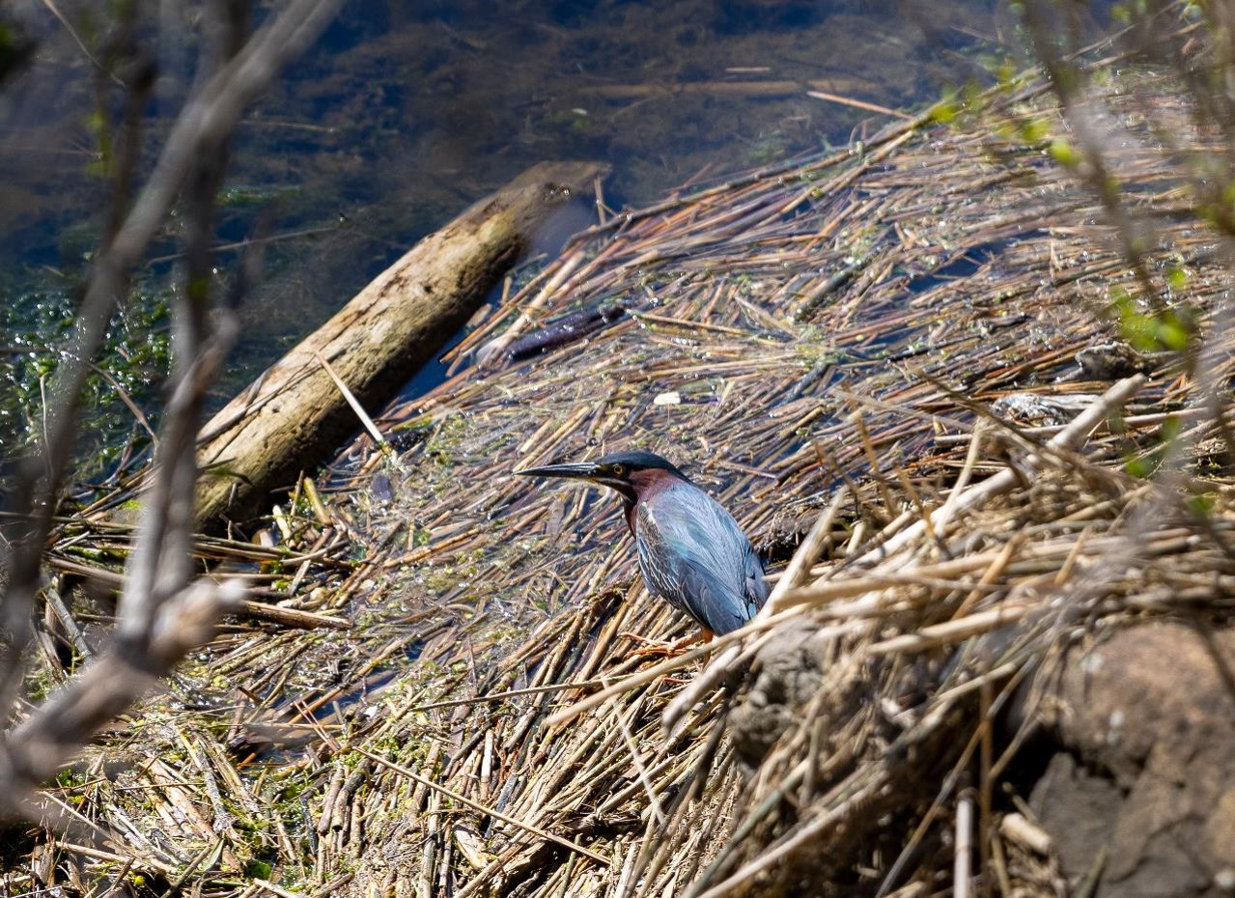
Thank You!
Hepburn Living Shoreline – Post Construction Green Heron Habitat Monitoring

