Slide 1
Climate Change in Connecticut:
Consequences and What to do
Jim O’Donnell

Slide 2
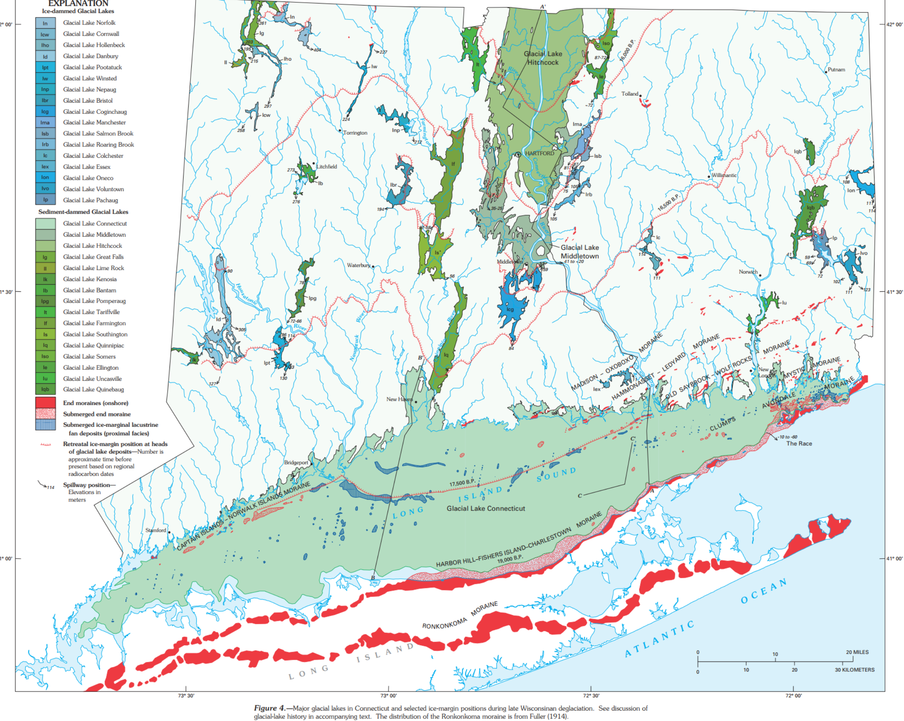
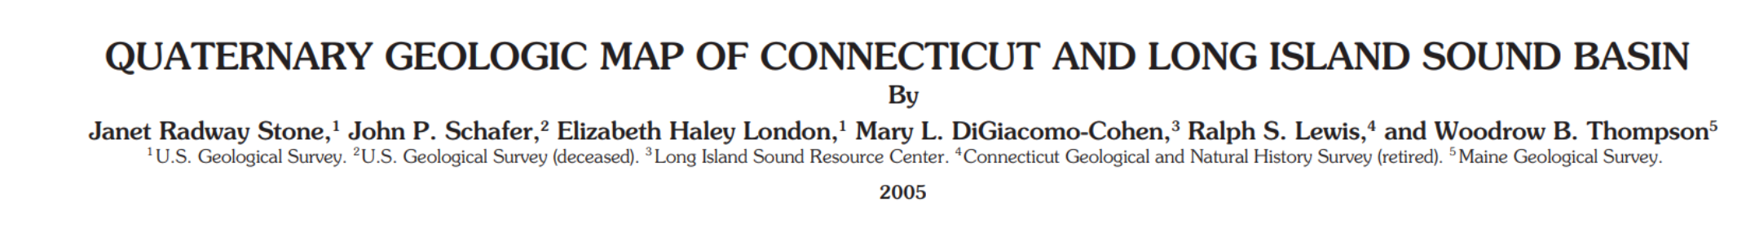

Slide 3
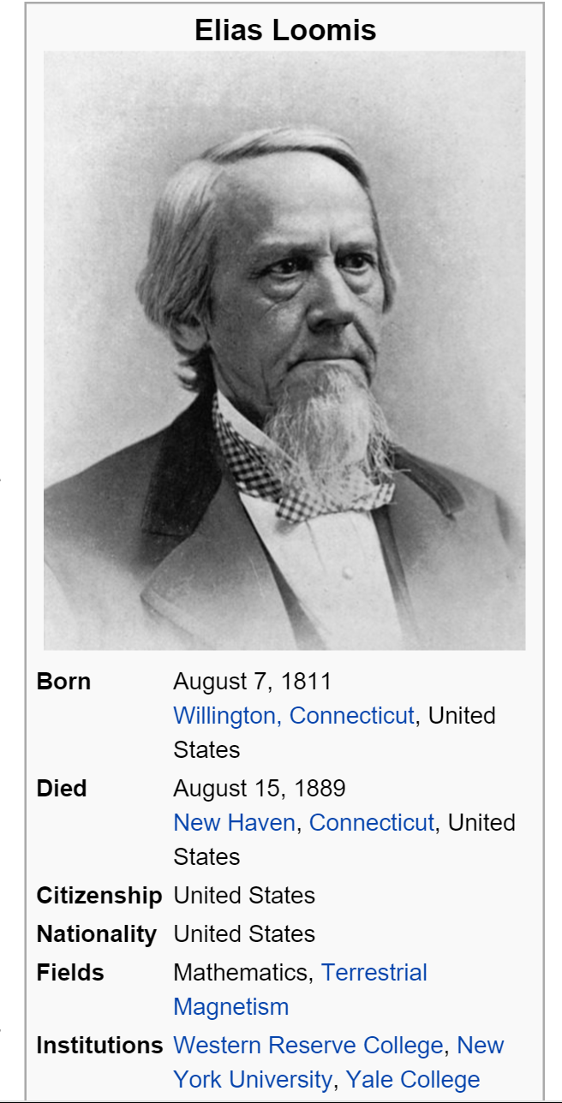
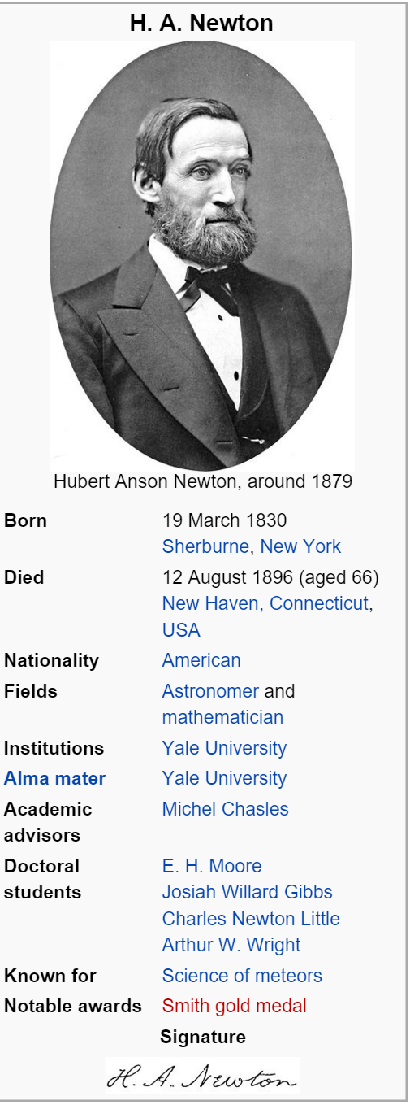
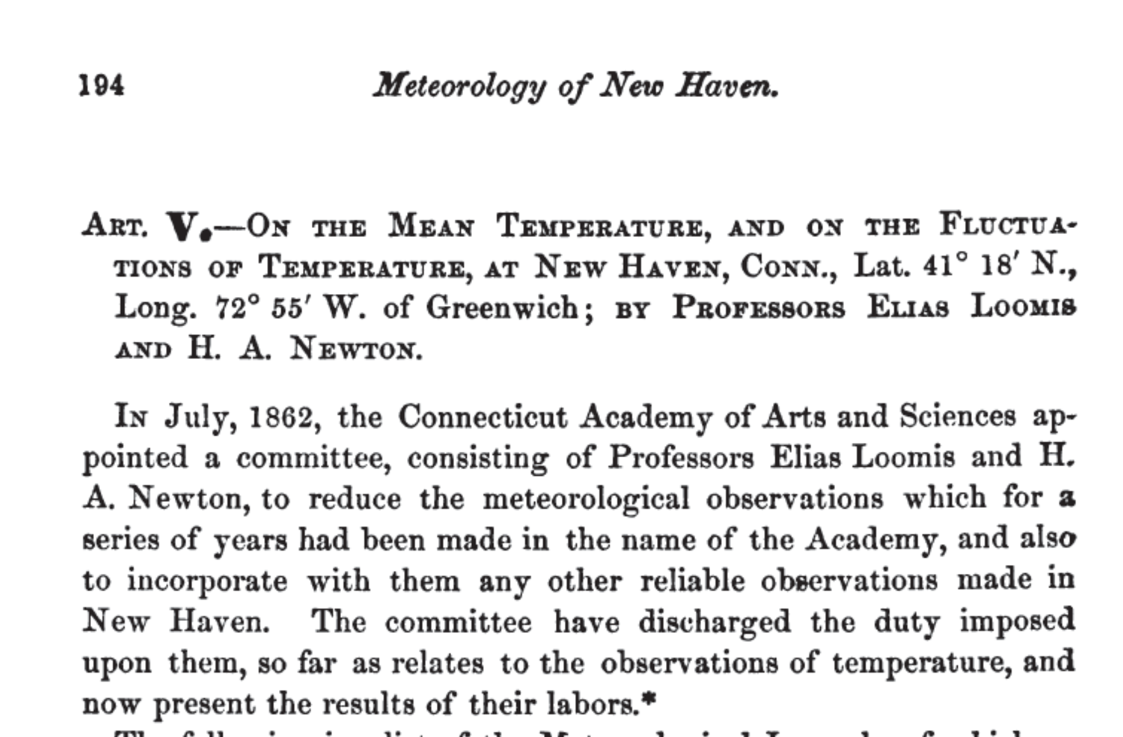

Slide 4
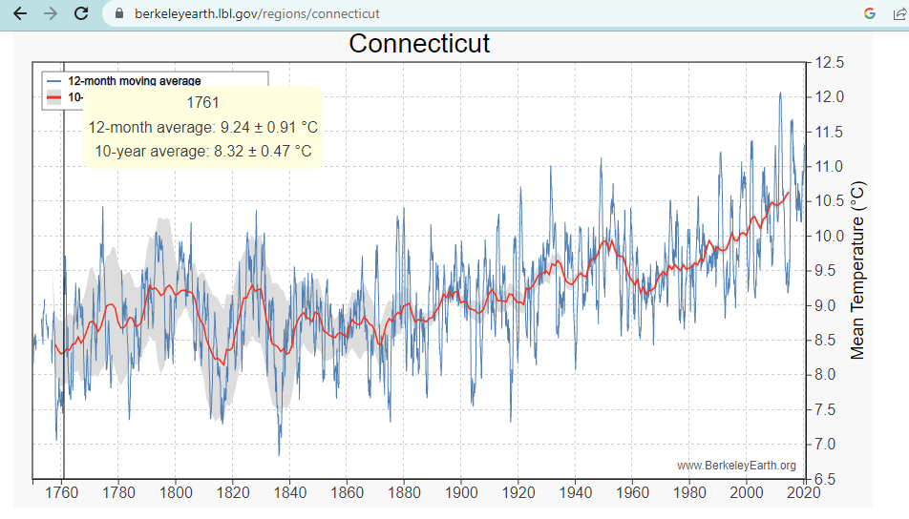
Area Averaged, Annual Mean Temp

Slide 5
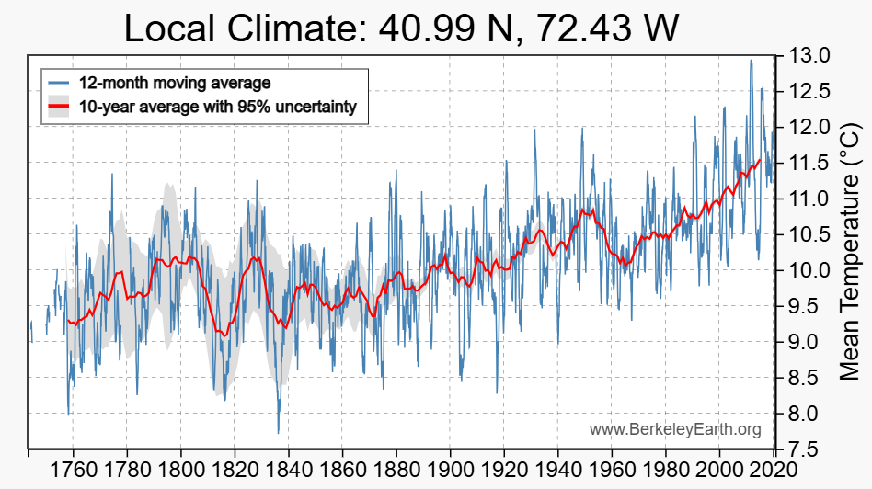
New Haven, CT

Slide 6
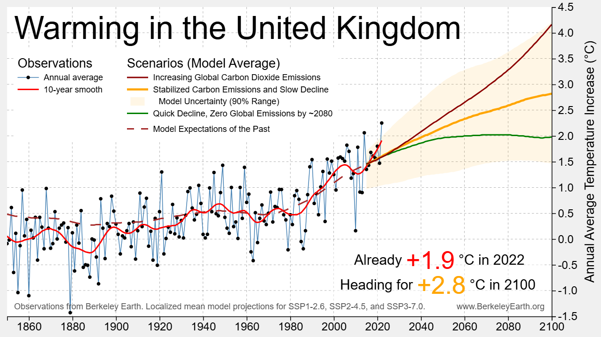

Slide 7
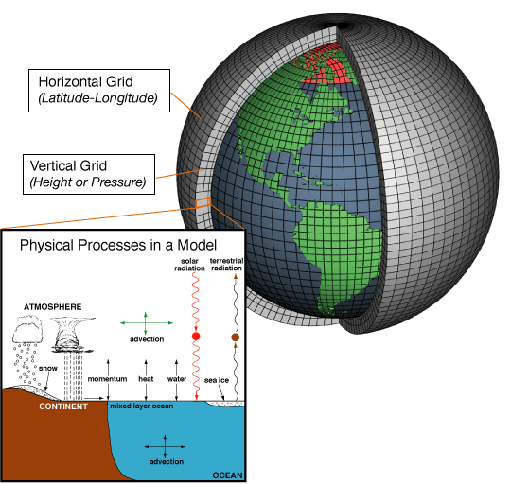
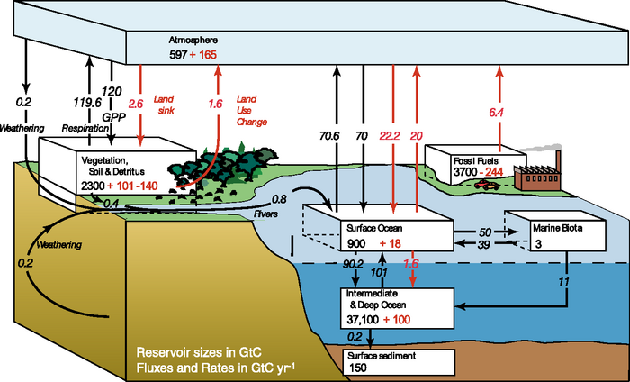
Physics
Intermediate Low – IPCC AR4 Models
Bio-geo-chem
https://www.ipcc.ch/publications_and_data/ar4/wg1/en/ch7s7-3.html
https://www.climate.gov/file/atmosphericmodelschematicpng

Slide 8
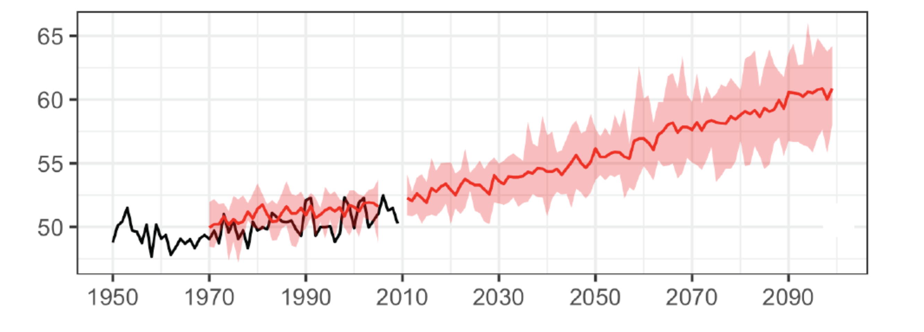
Measurements and model projections (with no CO2 reductions) of annual mean temperature in CT – CIRCA’s PSCAR report (Seth et al, 2019)
Plan for:
Air warming UP TO 5ºF (3ºC) by 2050

Slide 9
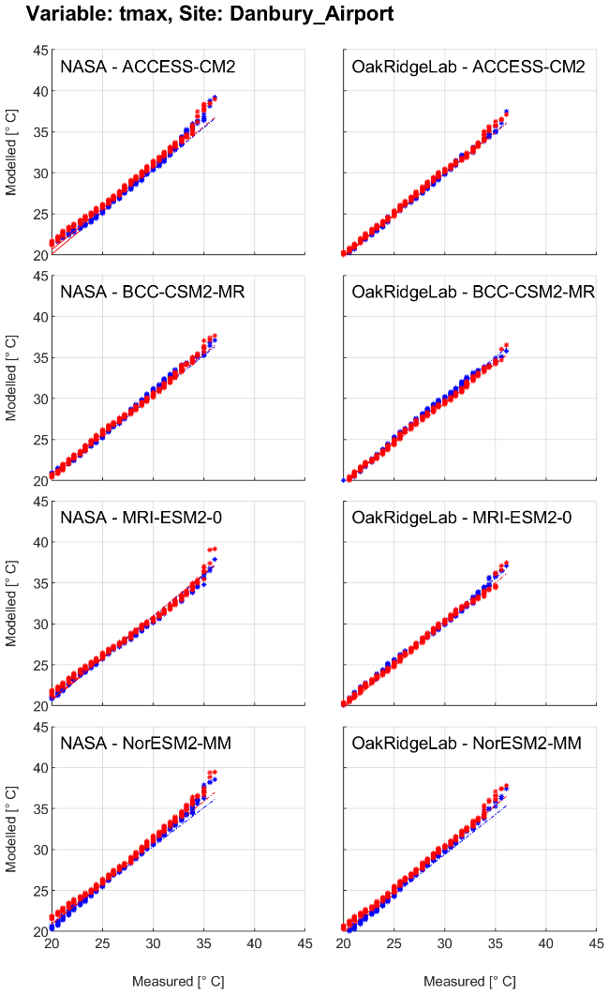
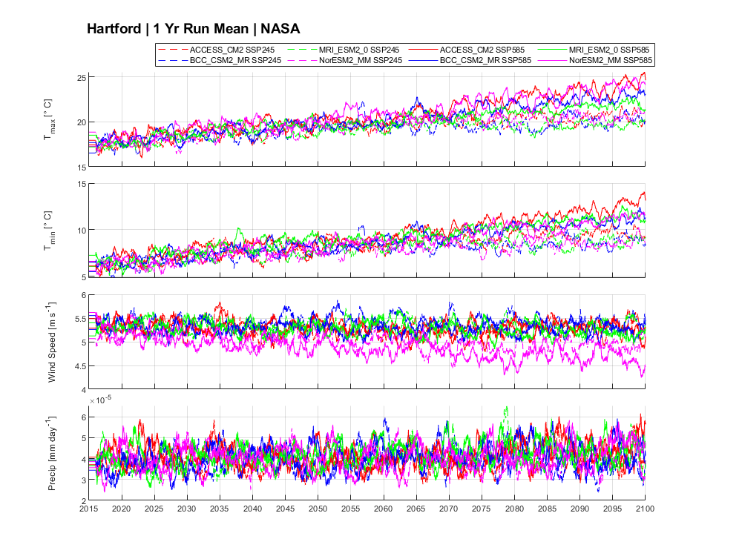

Slide 10
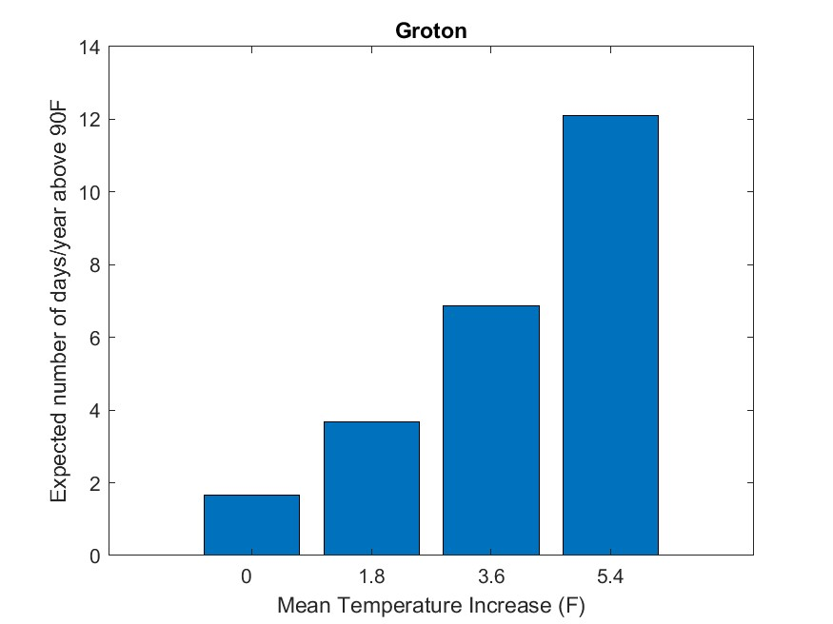
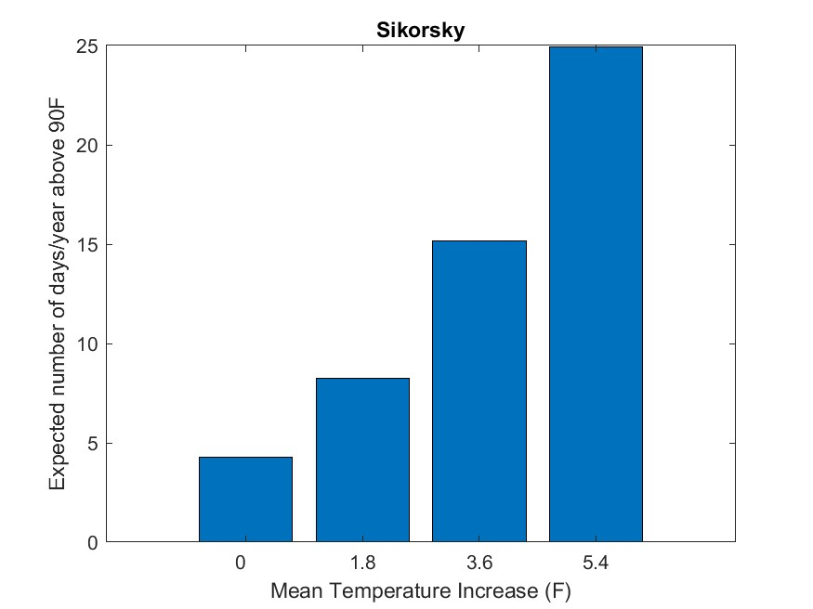
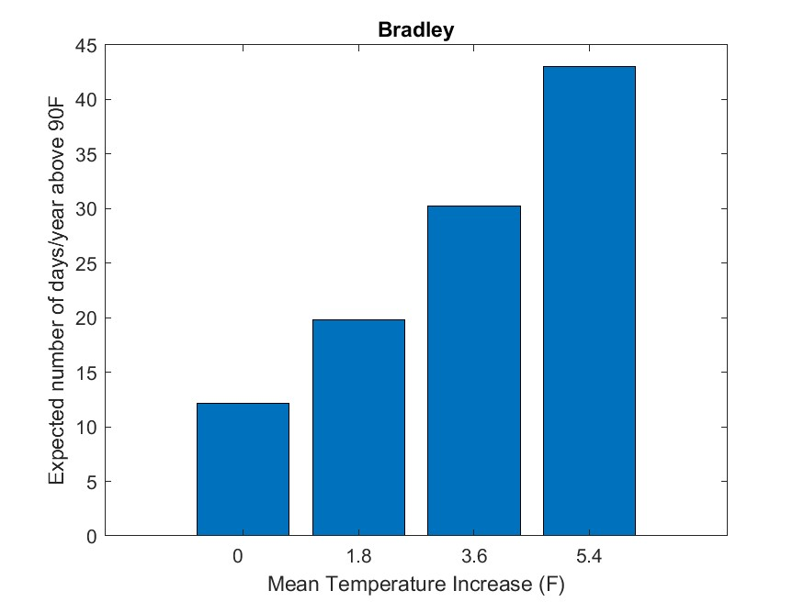

Slide 11
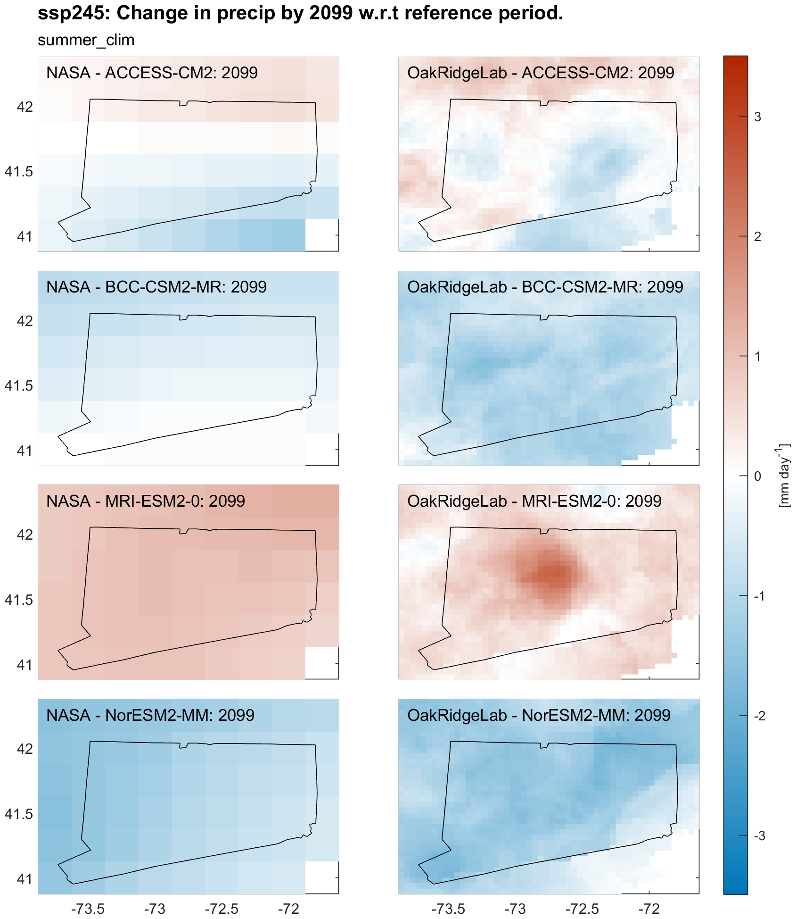

Slide 12
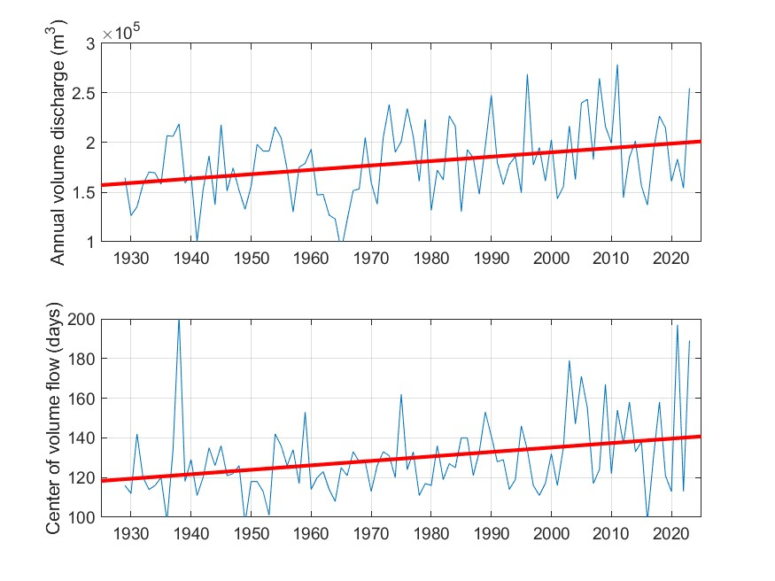
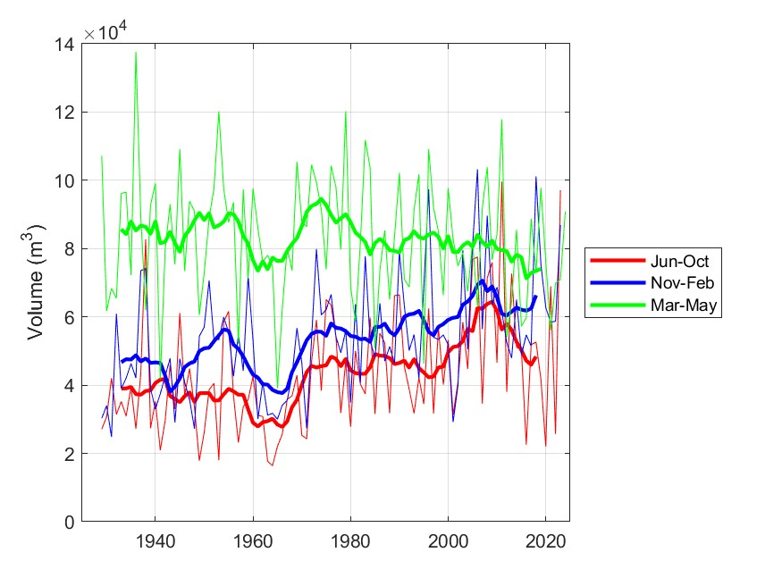
Changes in the CT River Flow

Slide 13
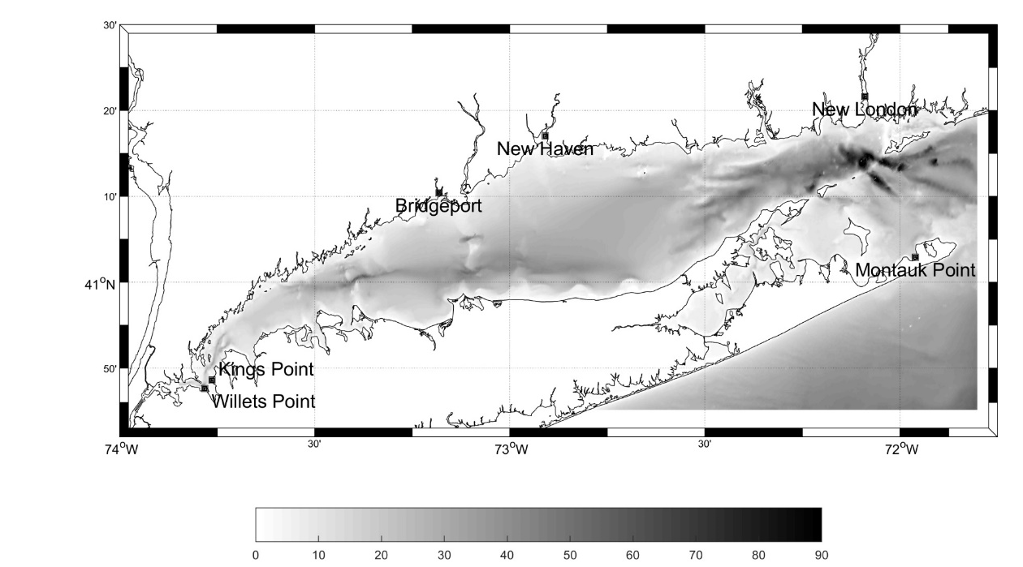
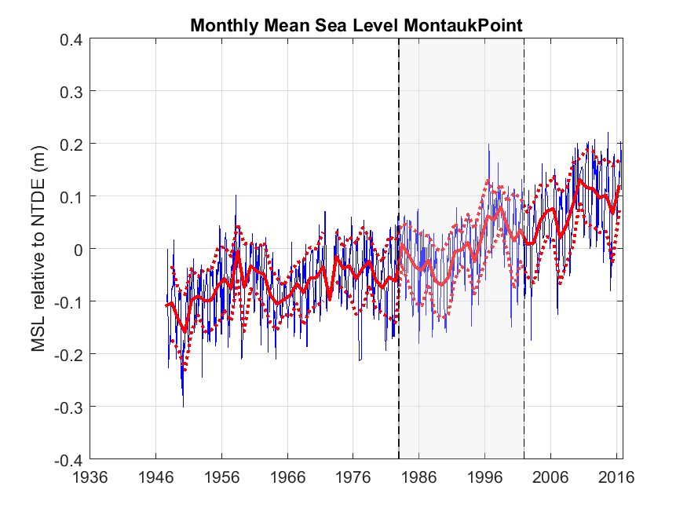

Slide 14
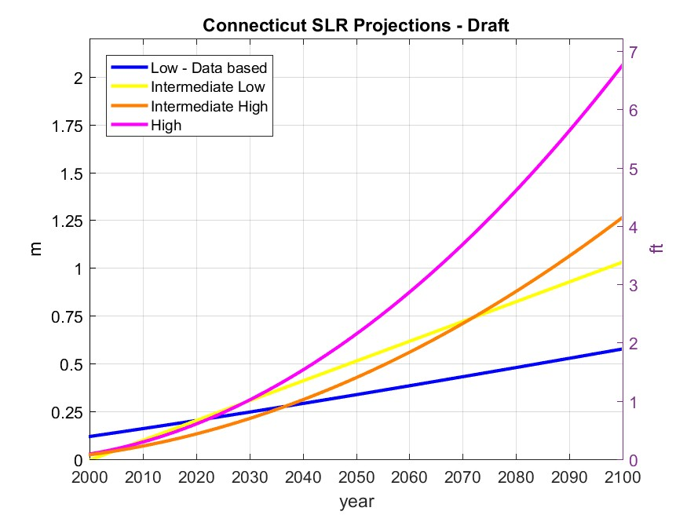
Figure 1. Sea level rise projections for Connecticut based on local tide gage observations (blue), the IPCC (2013)
RPC 4.5 model simulations near Long Island Sound (yellow line), the semi-empirical model predictions are in
orange and the magenta shows the ice mass balance projections.
Four projections of annual mean sea level at the CT shore
20in/50cm at 2050
Decadal Review
Alert people about the prospect of 100cm by 2100
Caution Threshold
Planning threshold

Slide 15
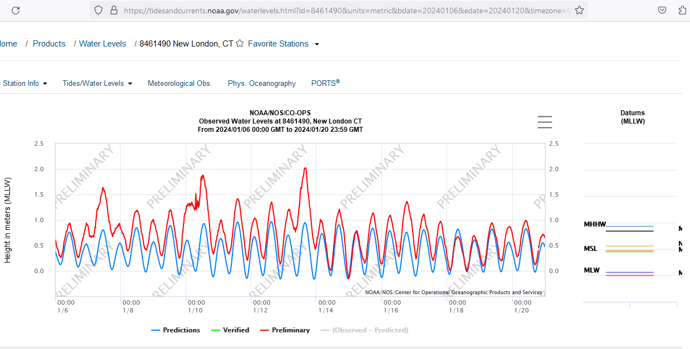
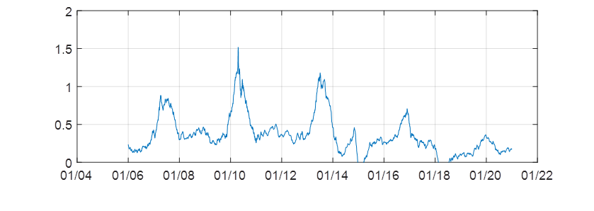

Slide 16
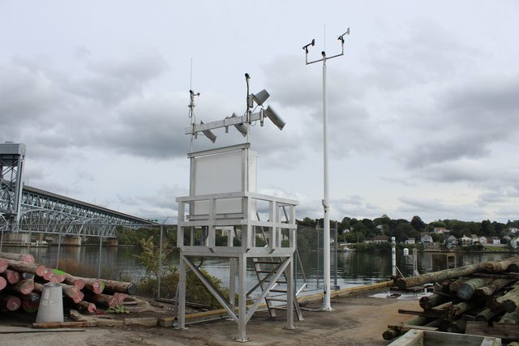
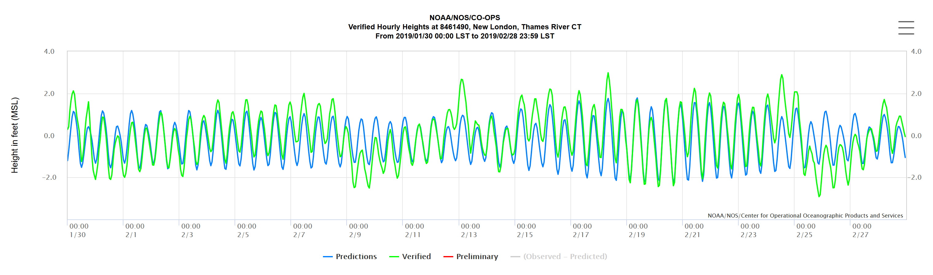
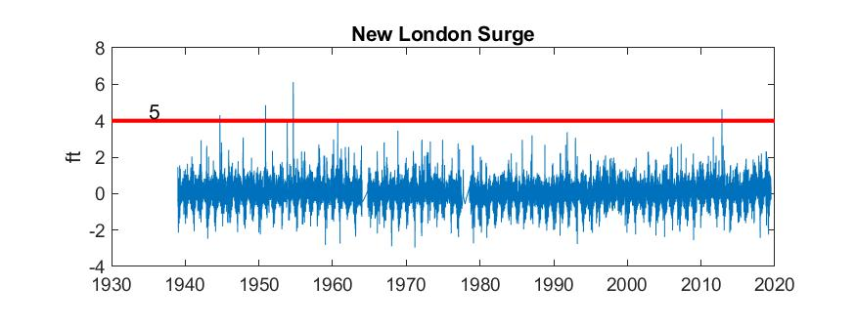
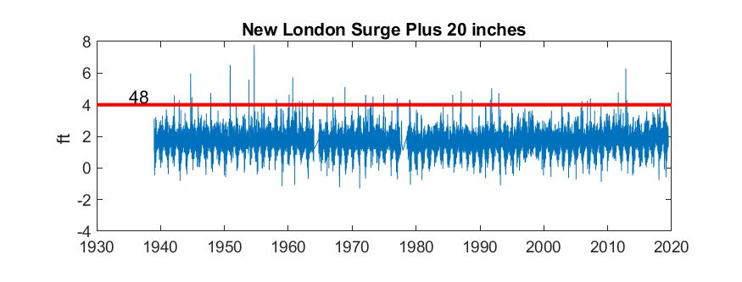
Modest changes in mean sea level have a big impact on flood risk
NOAA’s New London Tide Gage
Places that flood now when the surge is 4 ft have a 5/80 risk per year.
With a 20 inch mean SLR, that risk increases to 48/80.
The details are important here but the point is the change in risk is large.

Slide 17
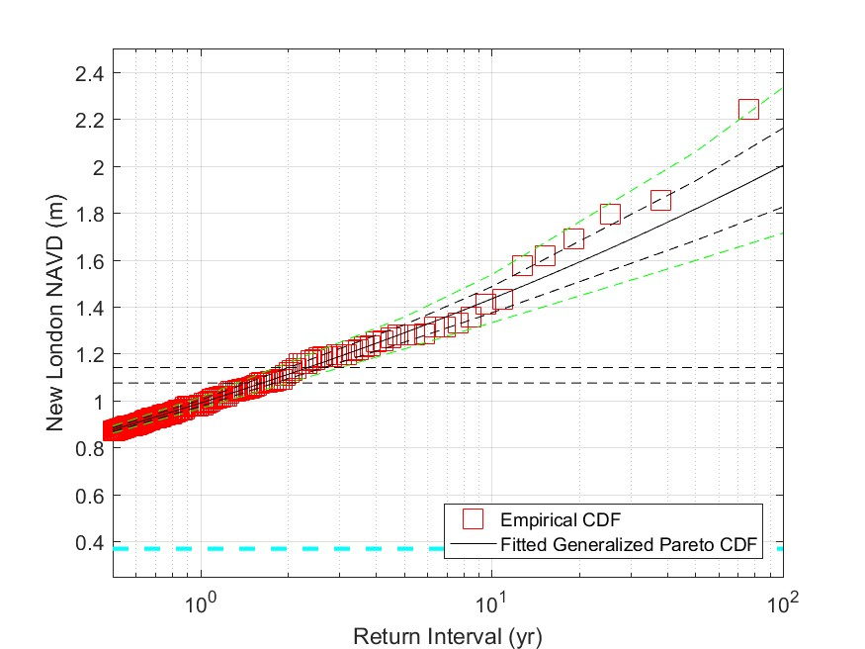
New London Total Water Level Return Interval
Currently the 10 yr return is ~1.45 m
If sea level increased by 0.25 m then storms would cause that every 2.5 yrs.
Note that is a 4 fold increase in flooding risk or frequency
25cm increase

Slide 18
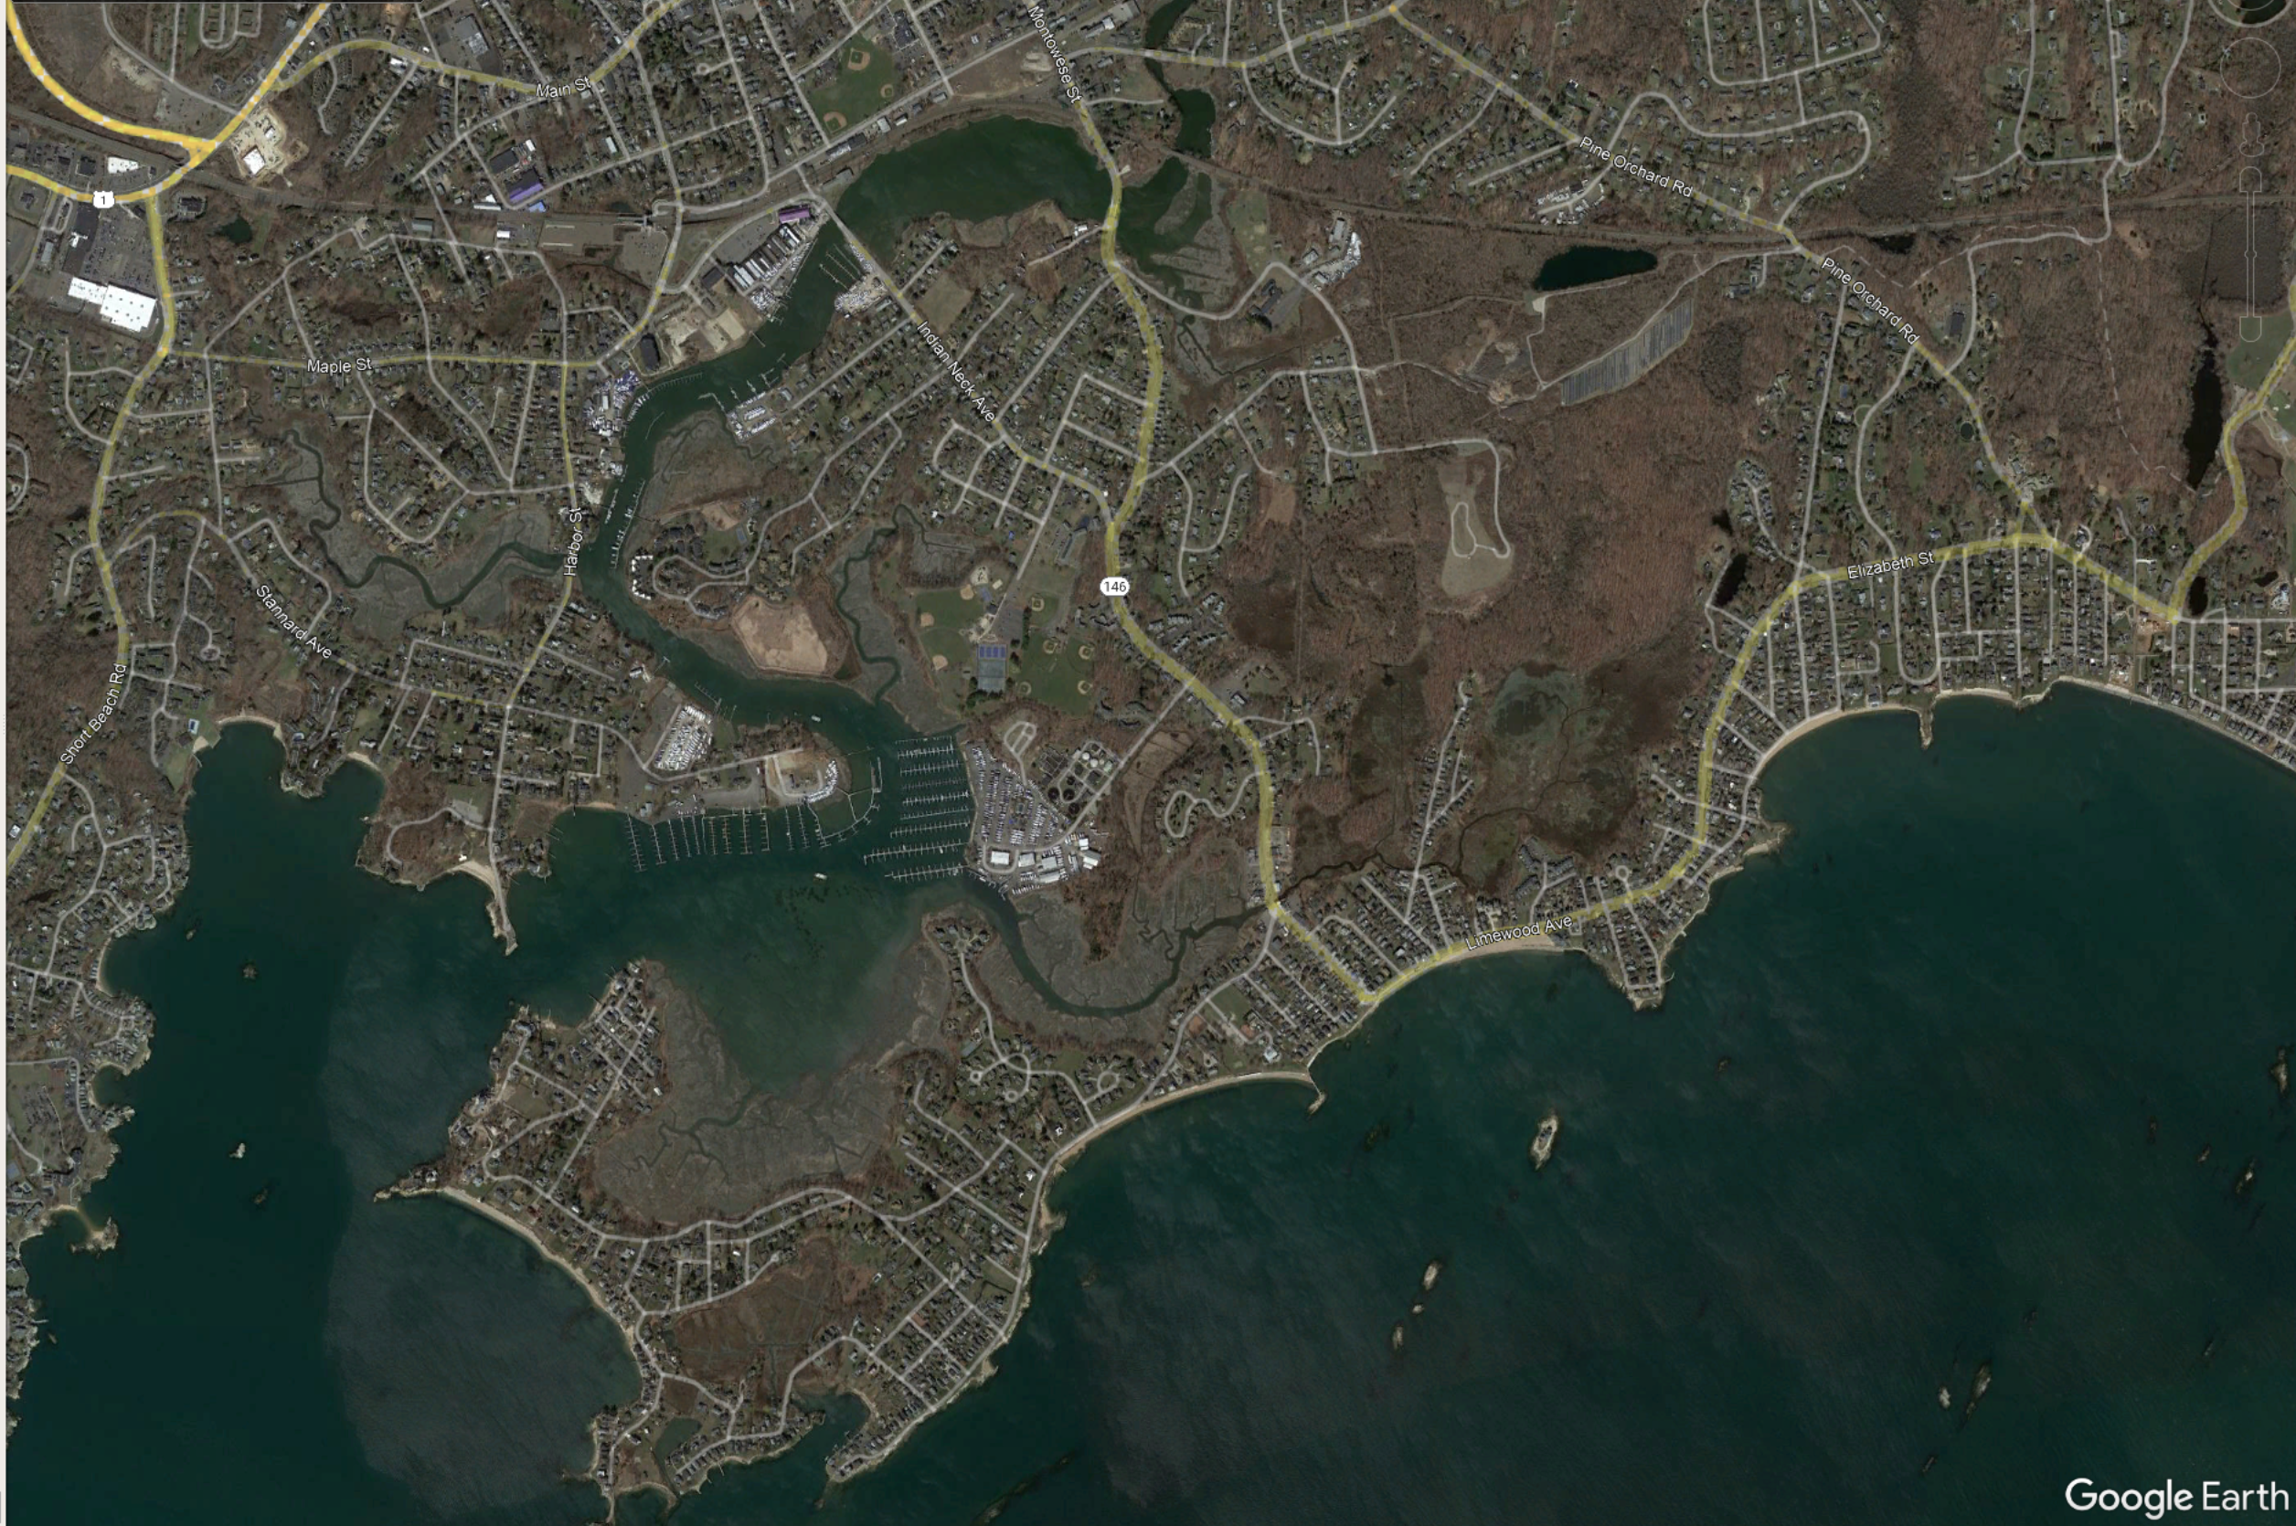
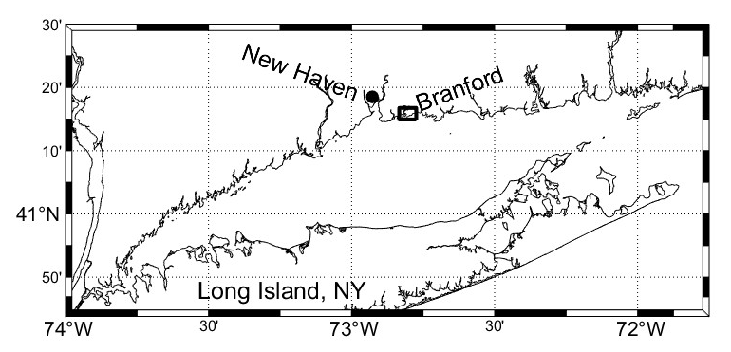
Rt. 146
Waverly Ave.
Branford River
Limewood Ave.
Sybil Creek
Indian Neck
Figure 2. The inset map on the upper left shows the coastline of Long Island Sound and the location of Branford,CT. The small rectangle identifies the area shown in the GoogleEarth© the aerial photograph. The road highlighted in yellow is Rt 146.

Slide 19
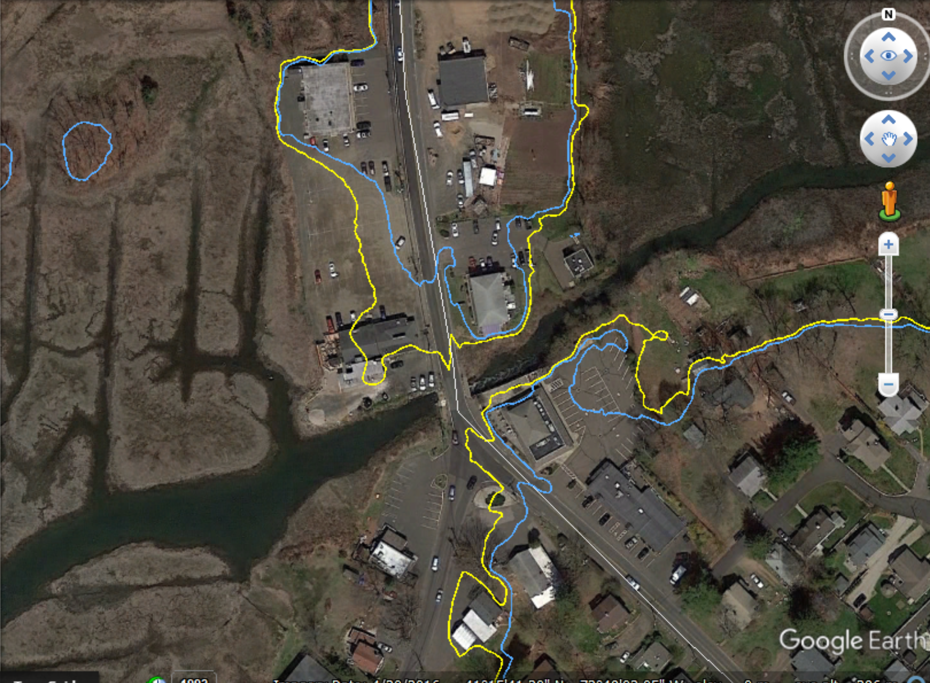
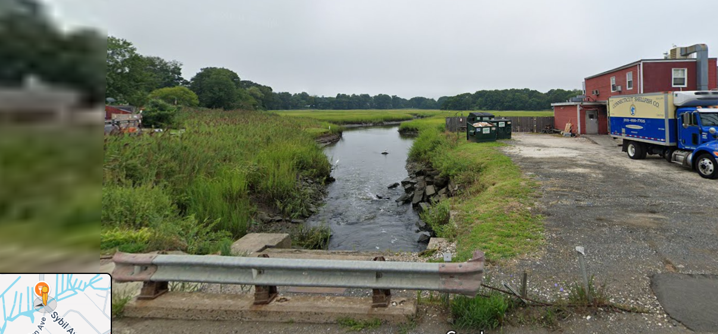
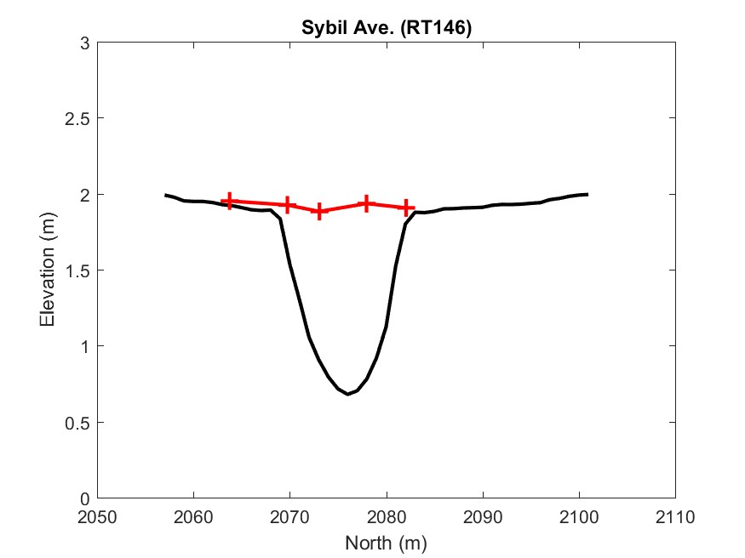
1.9 m
2.3 m
Linden Ave
Sybil Ave.

Slide 20
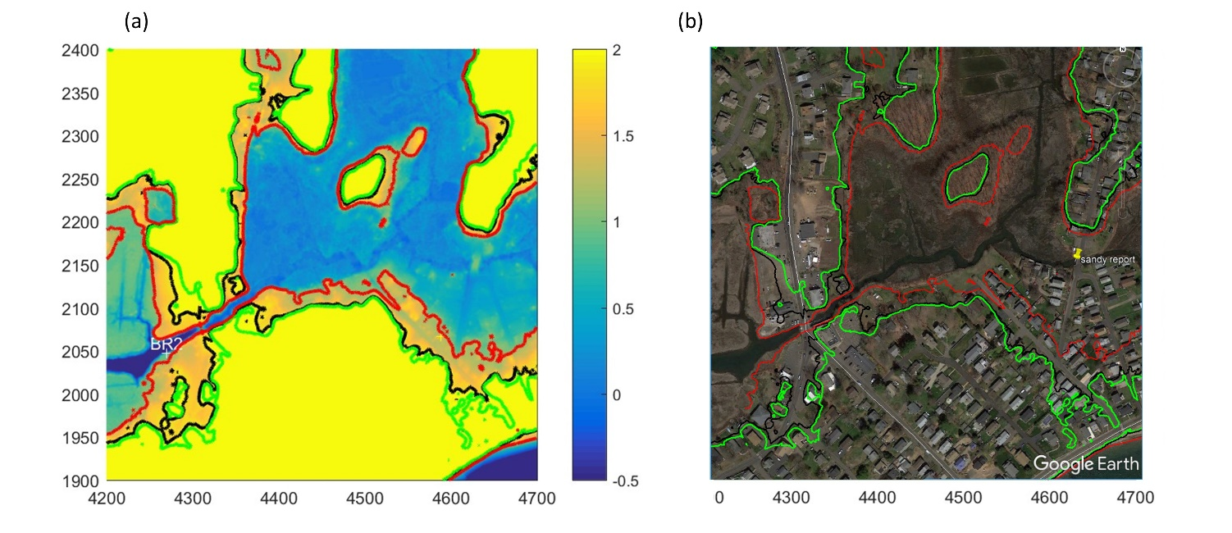
Black line shows the 1.9 m contour – The level of the Linden-Sybil Ave.
Green line shows the 2.15 m contour – The Level of Limewood Ave.
Red line shows the 1.1 m contour - The maximum water level in Sybil Creek Marsh.
1.1
1.1m
Vulnerable
Housing
2.15
2.15
1.1m
1.9m
1.1m
2.15
Tide Gate
2.15

Slide 21
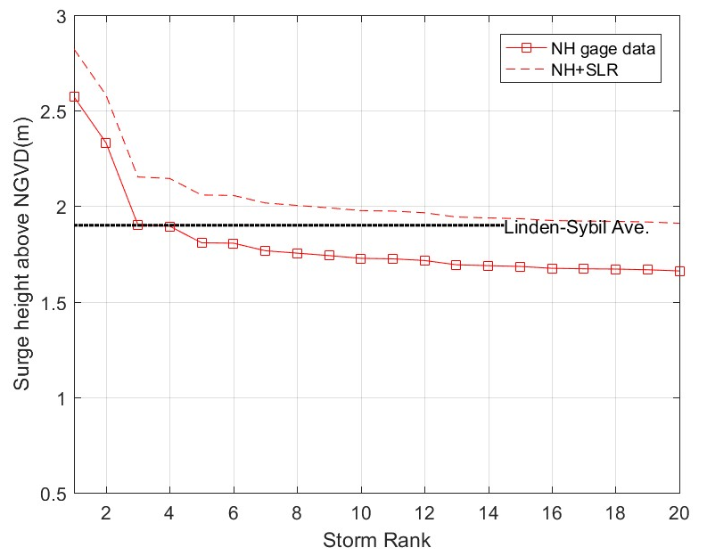
The 1.9 m level has been reached or exceeded 4 times since 1999.
An increase in MSL of 0.25 m would cause the road to be flooded 20 times (i.e. a factor of 5 increase in flood risk).
Total Water Level
Figure 50. The red squares show the levels of the 20 highest water levels observed at New Haven since January 1999. The dashed black line shows the level 1.9 m, which is the elevation of the road surface at the bridge across Sybil Creek. The dashed line is the levels that the water levels would have reached of the means sea level was 0.25 m higher.

Slide 22
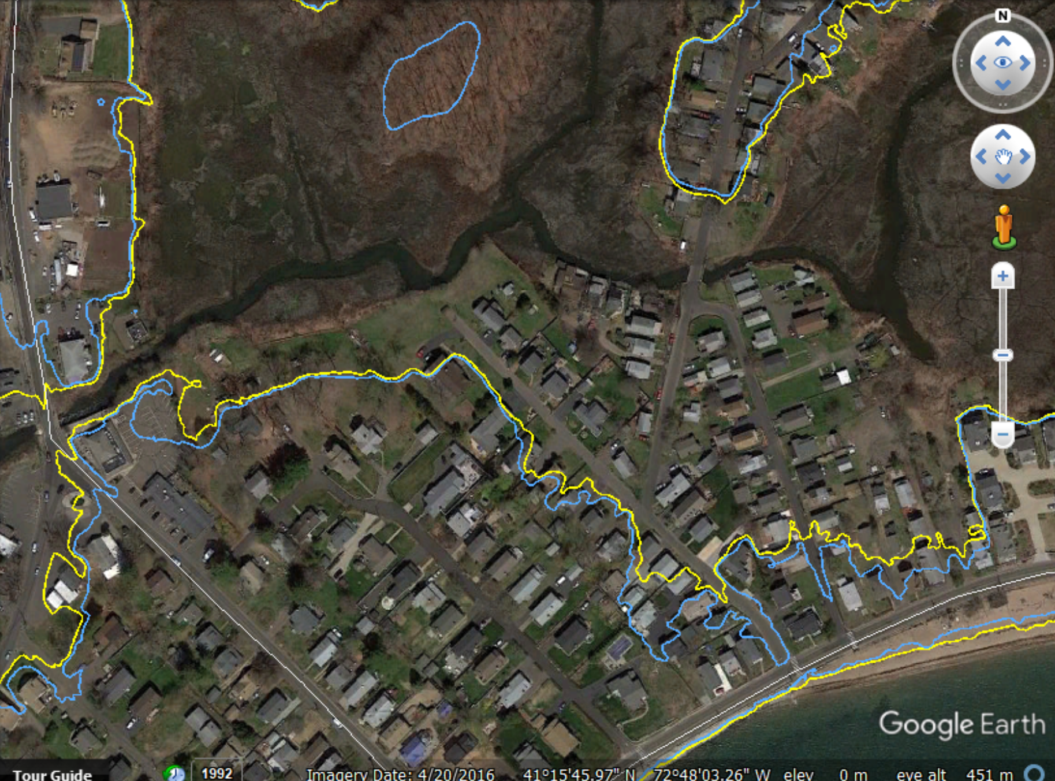
Waverly
Sybil Ave.
Limewood

Slide 23
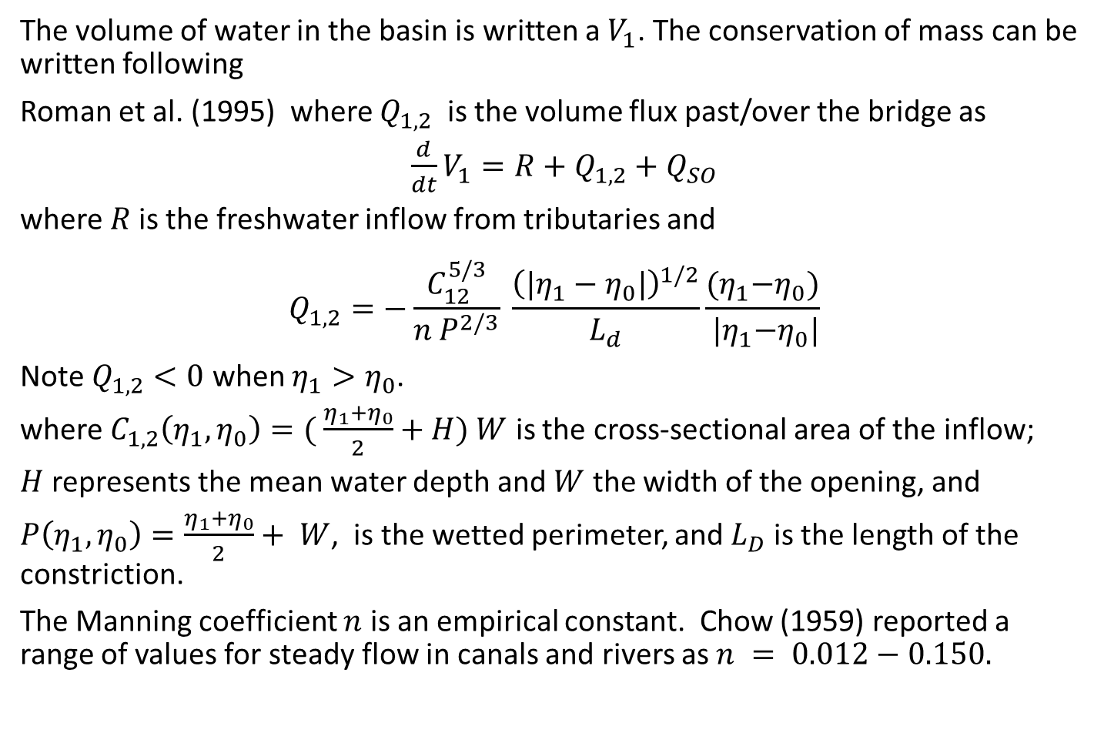
The volume of water in the basin is written a $V_{1}$. The conservation of mass can be written following
Roman et al. (1995) where $Q_{1,2}$ is the volume flux past/over the bridge as
$\frac{d}{dt}V_{1}=R+Q_{1,2}+Q_{SO}$
where $R$is the freshwater inflow from tributaries and
$$Q_{1,2}=−\frac{C_{12}^{5/3}}{n P^{2/3}} \frac{{\left({|η}_{1}−η_{0}|\right)}^{1/2}}{L_{d}}\frac{{(η}_{1}−η_{0})}{{ |η}_{1}−η_{0}|}$$
Note $Q_{1,2}<0$ when $η_{1}>η_{0}$.
where $C_{1,2}\left(η_{1},η_{0}\right)=( \frac{η_{1}+η_{0}}{2}+H) W$ is the cross-sectional area of the inflow;
$H$represents the mean water depth and $W$ the width of the opening, and
$P\left(η_{1},η_{0}\right)=\frac{η_{1}+η_{0}}{2}+ W$, is the wetted perimeter, and $L_{D}$ is the length of the constriction.
The Manning coefficient $n$ is an empirical constant. Chow (1959) reported a range of values for steady flow in canals and rivers as $n = 0.012−0.150.$

Slide 24
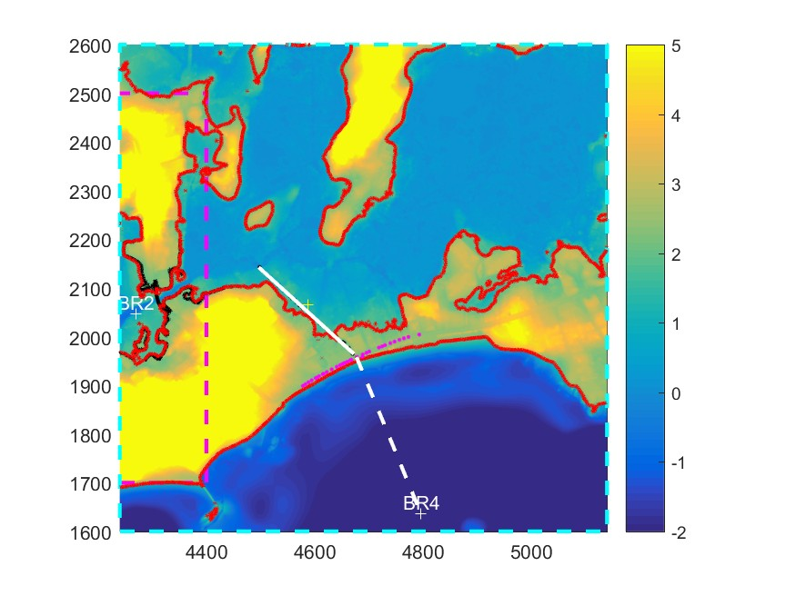
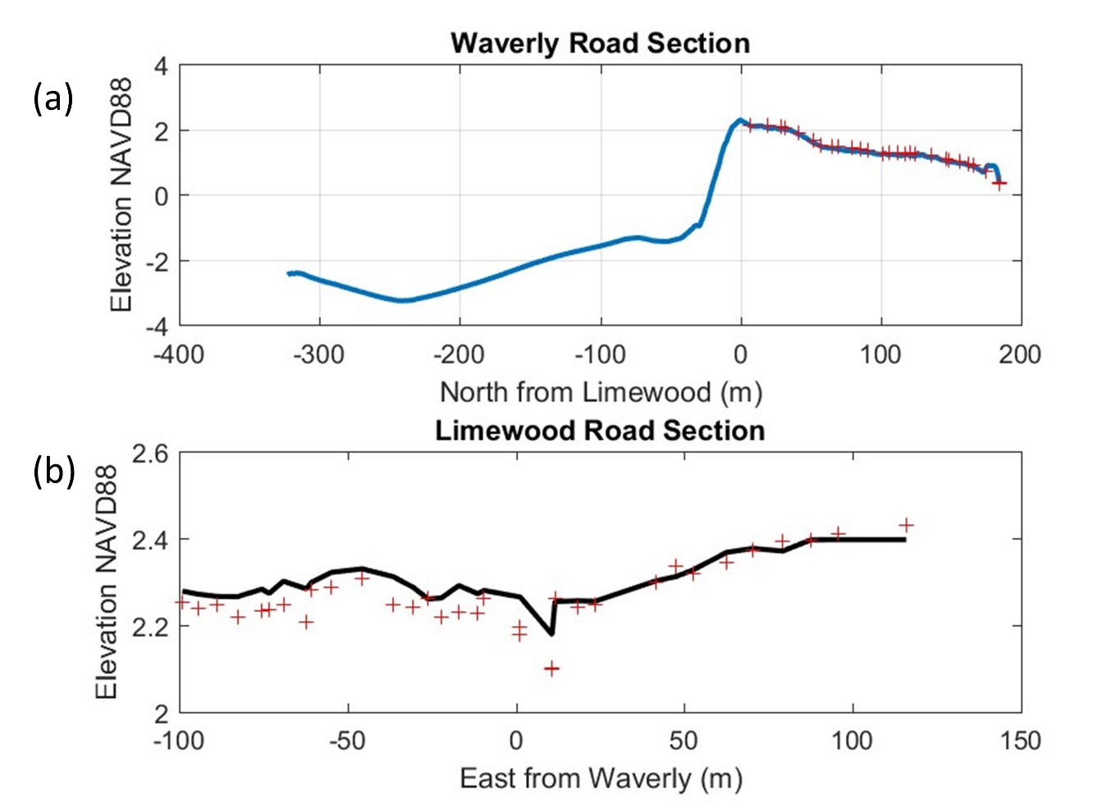
Figure 52. Topography of the Limewood Avenue –Waverly Road area. The color scale show the elevation in the range -2 to 5 m using the color scale on the right. The location of the water level and wave sensors at BR 4 is shown by the white + symbol. The magenta points lie on Limewood Avenue and the solid white line shows Waverly Road.
Figure 53. (a) The variation of water depth and land elevation along the dashed white line from BR4 to Limewood Avenue, and along the solid while line that shows Waverly Road in Figure 52. (b) The variation of elevation along Limewood Avenue. The zero of both graphs is at the junction of Limewood and Waverly. The red + symbols show measurements by RTKGPS

Slide 25
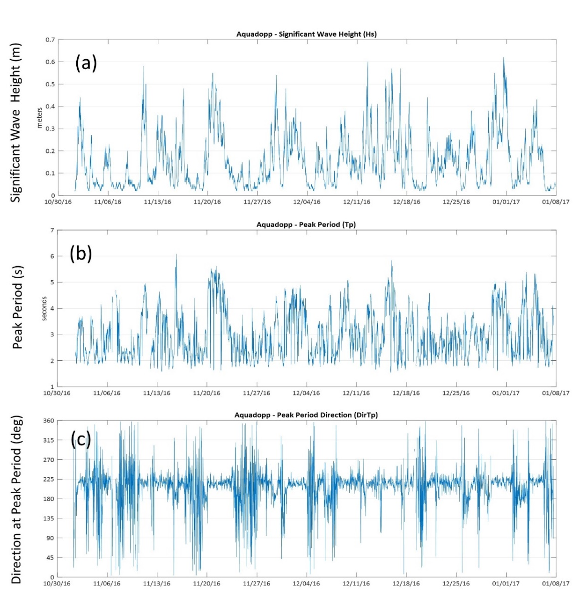
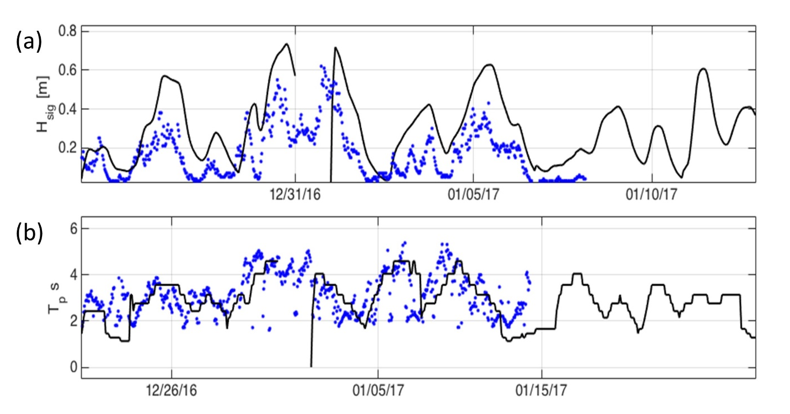
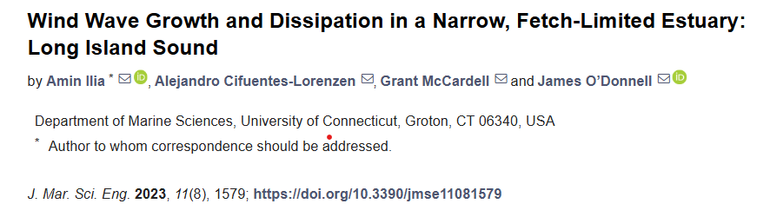
Simulation of the (a) significant wave height at BR4 and (b) the peak wave period.
Wave observations at BR4 from October 30, 2016 to January 8th, 2017. (a) shows the significant wave height (m), (b) the peak wave periods (s) and (c) shows the direction (degs.) the waves at the peak period were traveling from.

Slide 26
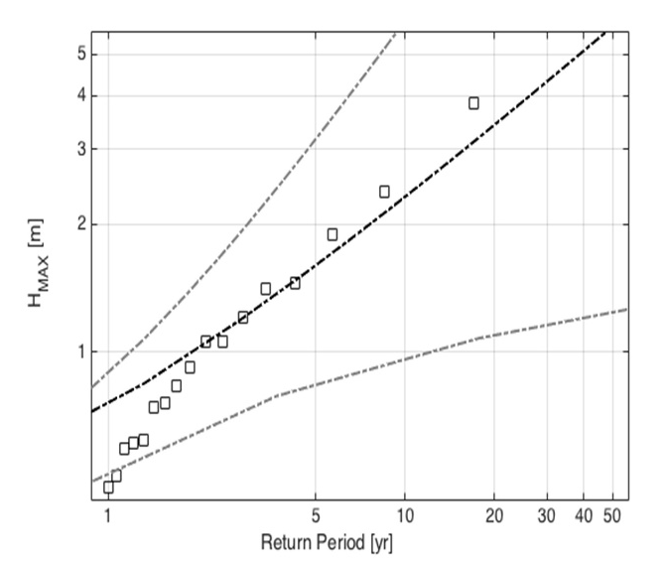
Table 2. Results of the simulations of significant wave height, H_{s} and dominant period T_{p} near Branford, CT.
Year | [m] | T_{p} [s]
1985 | 3.84 | 8.83
1954 | 2.38 | 9.67
2012 | 1.89 | 7.37
2011 | 1.45 | 6.73
2017 | 1.41 | 6.75
2008 | 1.31 | 4.68
2014 | 1.21 | 5.92
2006 | 1.06 | 5.12
1991 | 0.93 | 4.61
2015 | 0.76 | 5.61
1978 | 0.75 | 5.61
2013 | 0.62 | 4.27
2007 | 0.61 | 4.05
2005 | 0.59 | 4.05
2016 | 0.51 | 2.26
2003 | 0.48 | 4.05
2009 | 0.41 | 3.56
2011 | 0.37 | 4.68
Return period of significant wave heights Branford, CT. The dashed black line corresponds to the best-fit GEV function and the grey dashed lines mark the 95% confidence interval. The black squares show the maximum significant wave height (m) in the simulations at the site.

Slide 27
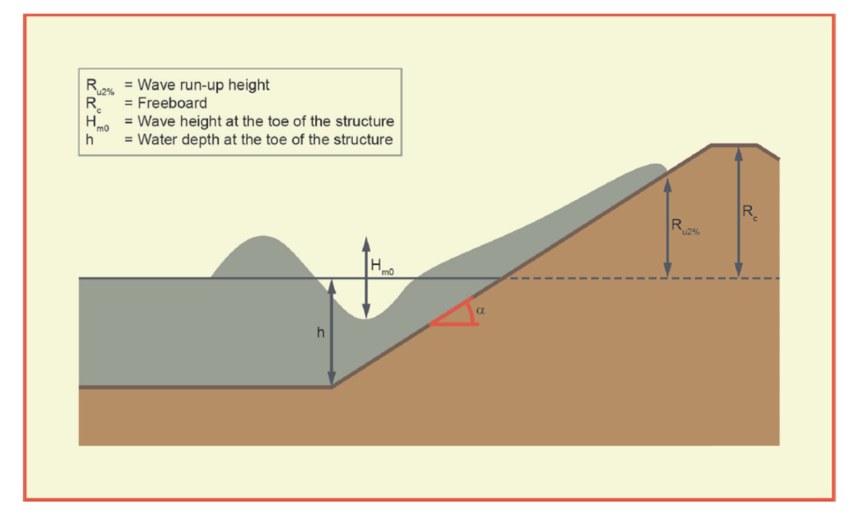
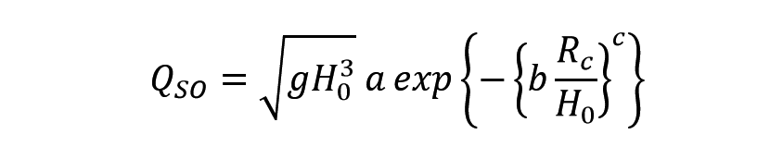
Schematic of an idealized coastal dyke or embankment defined in the EurOtop II report (Van der Meer et al., 2016).

Slide 28
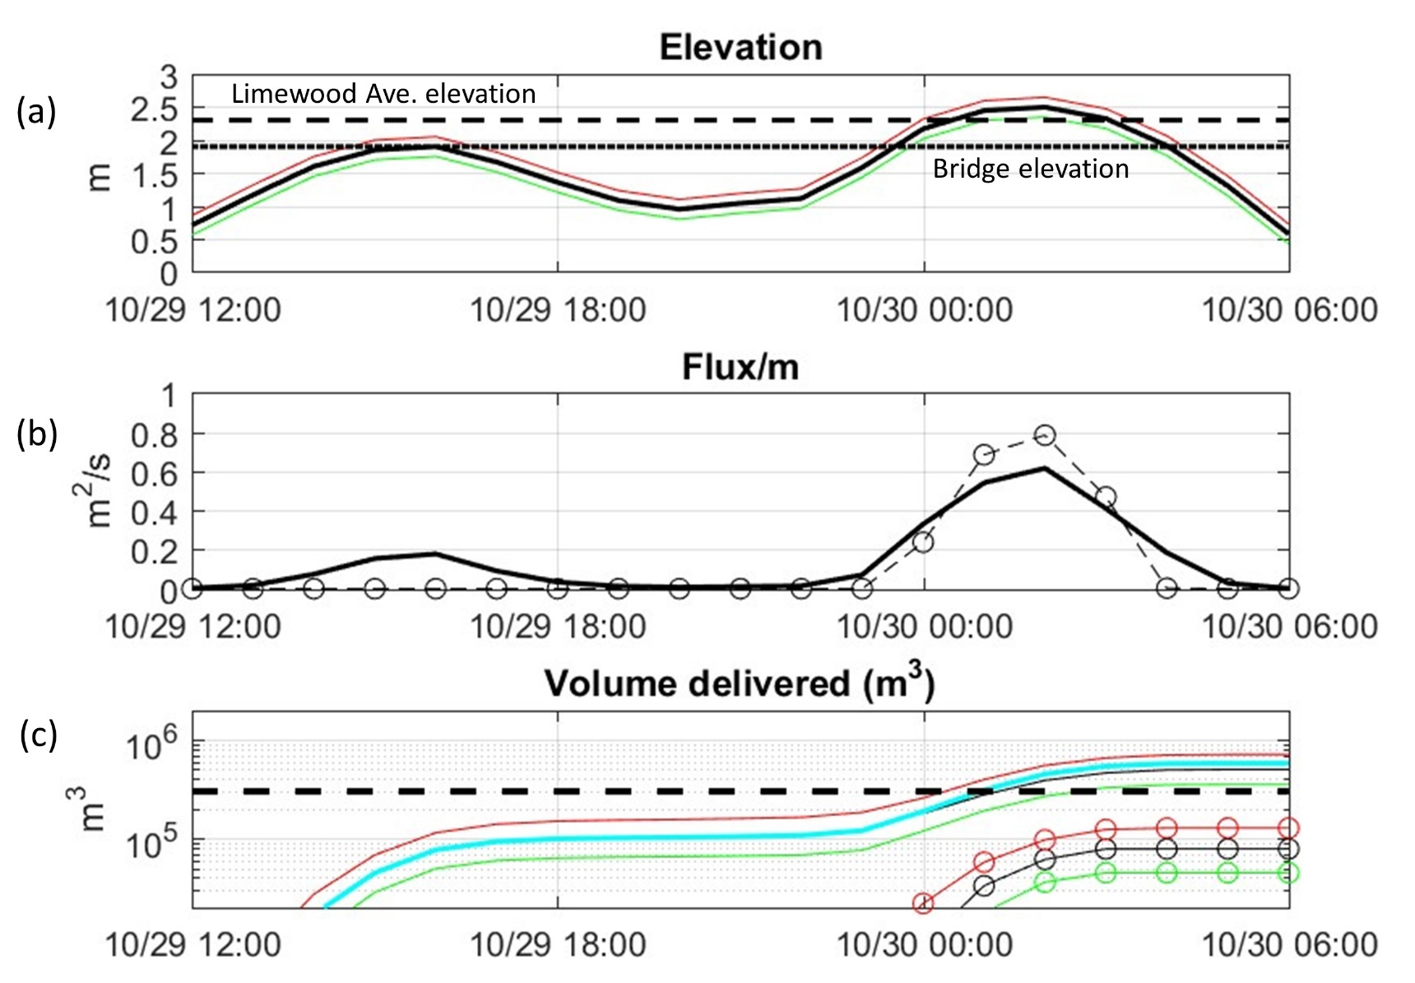
splashover at
Limewood
Final USGS Vol
Splash over at Limewood
Overtopping at Sybil

Slide 29
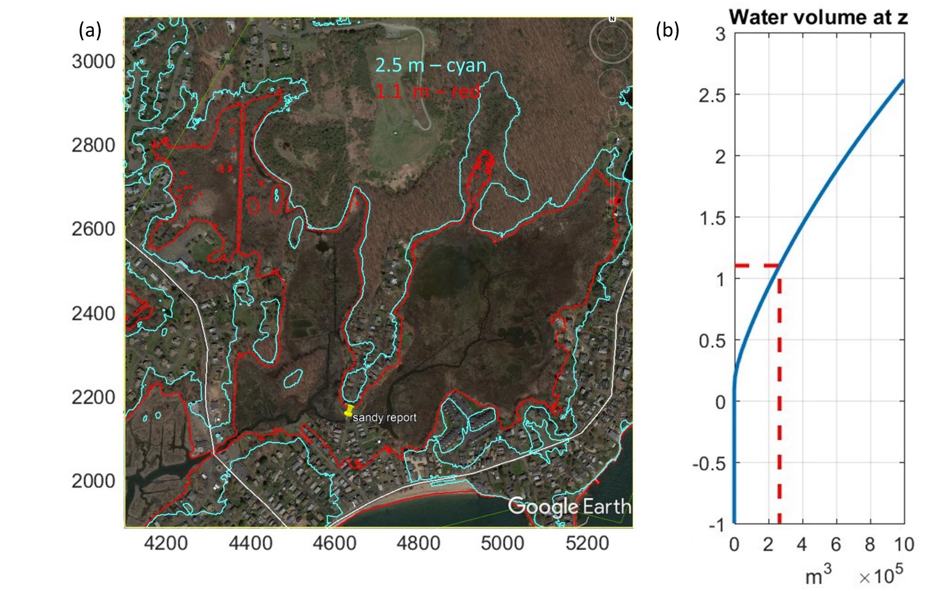
Figure 59. (a) A GoogleEarth map with the location of the USGS high water mark (site CTNEW19322) shown by the yellow push-pin. The 1.1 and 2.5 m elevation contours are shown by the red and cyan lines respectively. The volume required to fill the basin to the 1.1 m elevation is shown in (b).

Slide 30
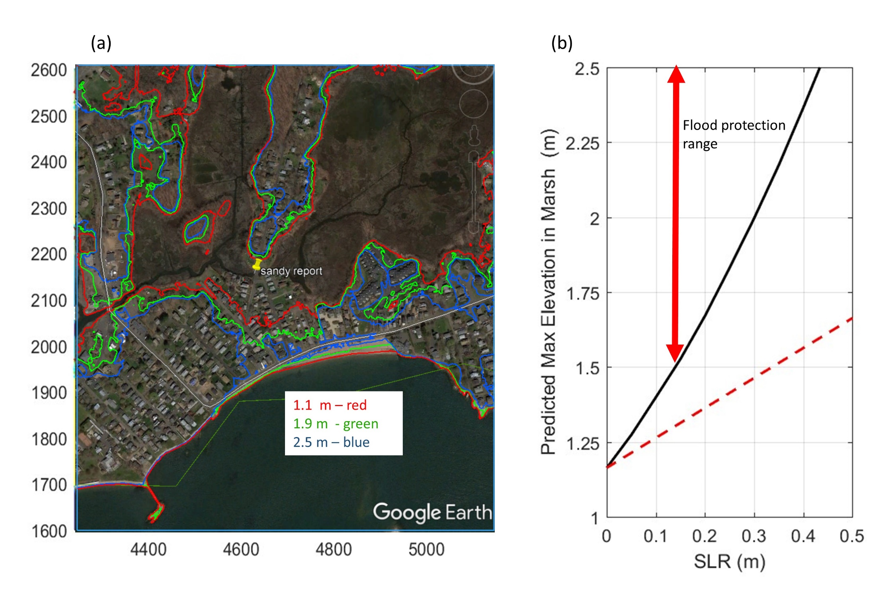
Flood protection lost
Figure 62. (a) A GoogleEarth map of the coastal area near Limewood Avenue. The white line show the location of RT 146 and the red, green and blue lines show the 1.1 m 1.9, and 2.5 m elevation contours. (b) The black solid line shows the elevation in the marsh that corresponds to the maximum predicted volume transported into the marsh. The red dashed line shows the change in sea level in the marsh if it was just do to sea level rise.

Slide 31
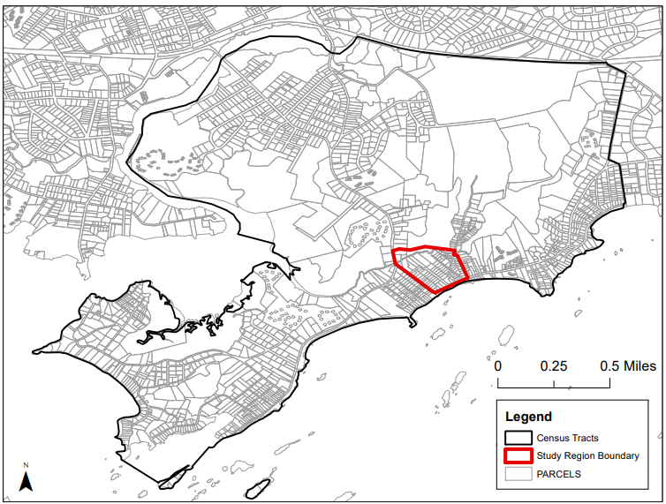
SUMMARY
To assess the future risk of flooding we built a simple basin model that resolves the critical details of flooding pathways and represents the flux from the ocean using well-stablished hydraulic models.
We estimate the over-topping flux from Limewood Avenue and the flow over Sybil Creek Avenue into the marsh during Sandy and find that the predicted high-water level in the marsh was similar to that observed by the USGS survey.
Most of the water in the marsh resulted from splashover.
Even though the fluxes were high, the large area of the marsh contained the flood volume below the 1.1 m level avoiding flooding in many residences.
At a 0.25 m higher mean sea level, simulations show that the flood protection value was lost and a Sandy-like event would cause flooding around the marsh to 1.9m.
The area considered at-risk in HAZUS doesn’t conform with the contours.

Slide 32



Slide 33

What should we do

Slide 34


Slide 35


Slide 36


Slide 37


Slide 38
Summary
Small changes make a big difference
It is very likely that we will get more heat waves and more frequent flooding.
Problems need to be addressed locally
Adapting housing, roads and public infrastructure will be necessary… and costly.
We need to figure out how to do it cost-effectively and equitably.
We need to get on with it.

